Slide 1
Hazmat Recap
2023 Runs
1/27/2023 – Ripley County – Overturned Semi
2/20/2023 – Forest Park FD – unknown
3/4/2023 – Blue Ash FF - Nitrogen
Upcoming trainings:
Warren County LEPC Exercise – Functional, 4/12/2023 (0800-1200)
Hamilton County LEPC Exercise – Functional – 11/3/2023 (EOC Exercise)
Hazmat Officer/Hazmat Safety Officer (3 days, must complete all)Tentatively 7/5, 7/19, 8/2
Incident Response Consideration for Lithium Battery Emergencies (Late Summer/Early Fall, 2 class offerings)
PER222 Public Safety Sampling (Late Fall)

Slide 2
Active911
In the event of an Active Threat page out, PLEASE DO NOT RESPOND. Should we need hazmat response for any component of an active threat, an Active911 will be sent out indicating the response needed.
Active threats being police related (swatting incidents most recently) do not need all the extra specialty personnel.
For trainings, please indicate your availability so we can plan accordingly. We do not want to waste time if we only have 3 people.
For full team response, please indicate your response accordingly so we know if we need additional personnel

Slide 3
Radiation and Radioactive Material
Brief Overview and Detection

Slide 4
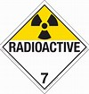
Radioactive Materials- Any material that contains unstable isotopes of an element undergoing decay and emitting radiation.
Sources:
Hazard Class: 7
Isotopes - P-32, S-35, I-125, C-14, etc.
Tritium H3.
Natural Uranium, Uranium Acetate, Thorium Nitrate.
Static Eliminators.
Radiation detector check sources.
All shipments of class 7 radioactive material must be done by Environmental Health and Safety
For DOT requirements, radioactive material means any material having a specific activity greater than 0.002 microcuries per gram (µCi/g).

Slide 5
Radiation – Ionizing vs Non Ionizing
Non Ionizing Radiation
Ionizing Radiation
Non-ionizing radiation has enough energy to move atoms in a molecule around or cause them to vibrate, but not enough to remove electrons from atoms.
Examples of this kind of radiation are radio waves, visible light and microwaves.
Ionizing radiation has so much energy it can knock electrons out of atoms, a process known as ionization. Ionizing radiation can affect the atoms in living things, so it poses a health risk by damaging tissue and DNA in genes. Ionizing radiation comes from x-ray machines, cosmic particles from outer space and radioactive elements. Radioactive elements emit ionizing radiation as their atoms undergo radioactive decay.
Radioactive decay is the emission of energy in the form of ionizing radiation

Slide 6
Alpha Particles
Positively charged and made up of two protons and two neutrons from the atom’s nucleus.
Alpha particles come from the decay of the heaviest radioactive elements, such as uranium, radium and polonium.
Even though alpha particles are very energetic, they are so heavy that they use up their energy over short distances and are unable to travel very far from the atom.
The health effect from exposure to alpha particles depends greatly on how a person is exposed.
Alpha particles lack the energy to penetrate even the outer layer of skin, so exposure to the outside of the body is not a major concern.
Inside the body, however, they can be very harmful.
If alpha-emitters are inhaled, swallowed, or get into the body through a cut, the alpha particles can damage sensitive living tissue.

Slide 7
Beta Particles
Beta particles are small, fast-moving particles with a negative electrical charge that are emitted from an atom’s nucleus during radioactive decay.
These particles are emitted by certain unstable atoms such as hydrogen-3 (tritium), carbon-14 and strontium-90.
Beta particles are more penetrating than alpha particles
but are less damaging to living tissue and DNA because the ionizations they produce are more widely spaced.
They travel farther in air than alpha particles, but can be stopped by a layer of clothing or by a thin layer of a substance such as aluminum.
Some beta particles are capable of penetrating the skin and causing damage such as skin burns.
However, as with alpha-emitters, beta-emitters are most hazardous when they are inhaled or swallowed.

Slide 8
Gamma Particles
Weightless packets of energy called photons.
Gamma rays are pure energy.
Gamma rays are similar to visible light, but have much higher energy.
Gamma rays are often emitted along with alpha or beta particles during radioactive decay.
Gamma rays are a radiation hazard for the entire body.
They can easily penetrate barriers that can stop alpha and beta particles, such as skin and clothing.
Gamma rays have so much penetrating power that several inches of a dense material like lead, or even a few feet of concrete may be required to stop them.
Gamma rays can pass completely through the human body; as they pass through, they can cause ionizations that damage tissue and DNA.

Slide 9
Radiation Exposure
Spend as little Time as necessary in the contaminated area.
Keep Distance between you and the radiation source per Dept of Transportation Emergency Response Guide:
80 -160 ft from radiological source
1,500 ft from radiological source with explosive Use Shielding between you and the radiological source.
If victims have particulate material on them they need to be decontaminated.

Slide 10
What are safe/unsafe levels of Radiation? EPA/OSHA Approved Levels
DOSE RATE Limits:
2mR/Hr = Recommended Hot Zone line.
10R/Hr = Turn Back Dose Rate all activities (except for life saving).
200R/Hr = Turn Back Dose Rate (even life saving).
Whole Body DOSE Limits:
Up to 5 REM Normal Incident Activities.
5-10 REM Activities to Protect High Value Property.
10-25 REM Life-saving or Protection of large populations.

Slide 11
What instruments do GCHMU carry that can detect Radiation?
RAD – 60 R
SAIC PD -3i-s
Identifinder
Ludlum
SAM940

Slide 12
My Unit has alarmed, what do I do?
Protect yourself, your crew and the public using TIME, DISTANCE, & SHIELDING.
1
Note the nature of the alarm (DOSE or DOSE RATE).
2
Contact the IC.
3
Notify the IC of the exact location of the activation.
4

Slide 13
Instrumentation
You will be given a brief overview of the radiation detection instrumentation that GCHMU carries aboard the ARU. Once finished, you will break out into groups and spend 10-15 minutes at each station. Here, you will get a chance to play with and learn about the various instruments we have for radiation detection.

Slide 14
RAD-60R
Electronic Radiation Dosimeter

Slide 15
RAD-60R Personal Dosimeter
Radiation detected: - gamma and X-rays
Detectors: - energy compensated Si-Diode
Measurement range: - dose: 1 μSv - 9.99 Sv or 0.1 mrem - 999 rem - dose rate: 5 μSv/h - 3 Sv/h or 0,5 mrem/h - 300 rem/h
Audible alarms: - eight separate alarms, sound level typically better than 85 dBA at 30 cm
Temperature range: RAD-60: -20 oC to +50 oC (-4 oF to 122 oF ) operational, humidity up to 90% RH, non condensed RAD

Slide 16
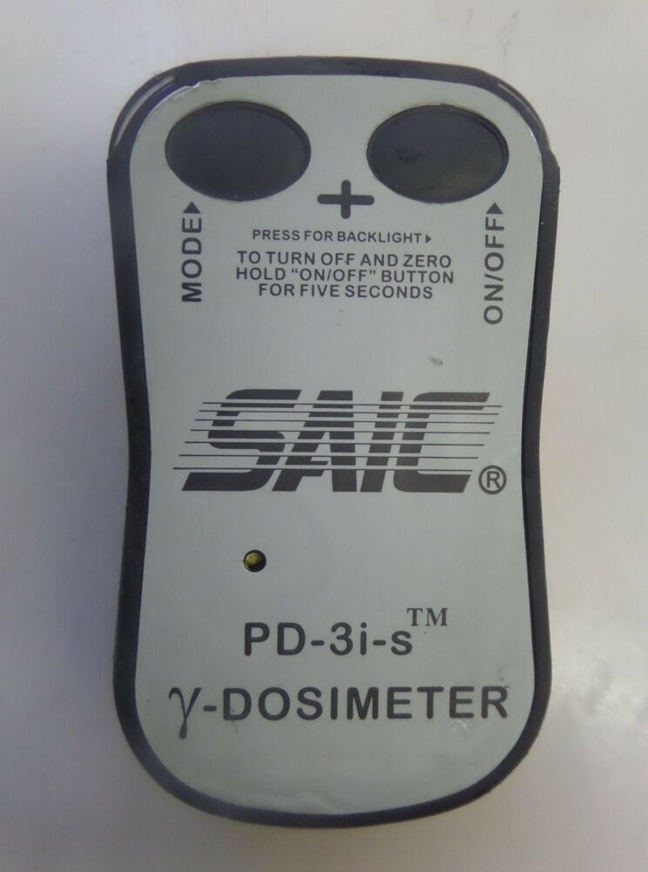
SAIC PD-3i-s Personal Dosimeter
Radiation detected: Gamma and X-Ray radiation.
The Dosimeter displays:
Dose "total amount of radiation accumulated" over a period of time
Dose Rate "the rate you are being exposed to the radiation“
Alarm Settings:
DOSE - 100mR
DOSE RATE - 2mR/Hr
NEVER STORE BATTERIES IN UNITS

Slide 17
identiFINDER R400
Gamma and Neutron Identification
Dose Range:
0 nSv - 1 Sv (0 nrem - 100 rem)
Dose Rate & Accuracy:
(Cs-137) 0 nSv/h - 10.00mSv/h (0 nrem/h - 1.0 rem/h); ±30 %
Gamma Spectrum:
1024 channels; 3 MeV
Geiger-Muller Dose Rate Range:
100 µSv/h - 10mSv/h (10mrem/h - 1.0 rem/h)
Neutron Sensitivity:
2.6 cps/nv; ±20 %
Scintillator Dose Rate Range:
0 nSv/h - 500 µSv/h (0 nrem/h - 50mrem/h)

Slide 18
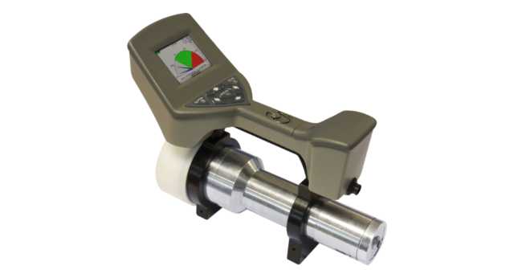
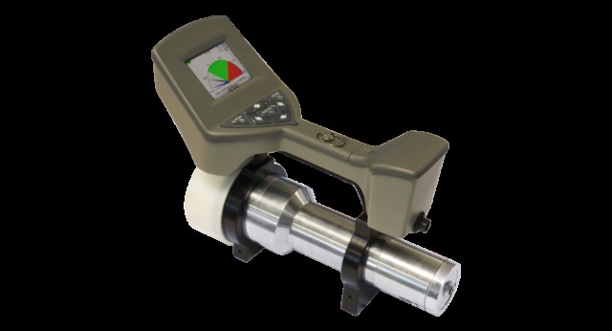
SAM 940
Handheld Radiation Isotope Identifier
https://www.berkeleynucleonics.com/sam-940-riid

Slide 19
SAM 940 (RIID)
Features
No Warm Up or Waiting Period
One Hand/One Glove Operation
Network Ready with ANSI N42.42 Data Transmission
Search and Confirm with One Instrument
COTS Batteries for Rapid Deployment
Highest Sensitivity and Response in Real Time
Operates Accurately in High Background
Auto Calibration and Stabilization with NORM
Cambio or Peak Easy Compatible
DOE Reachback Ready, JAC Ready

Slide 20
Ludlum 44-9 Pancake alpha, beta, gamma
The GM pancake-type detector in the Model 44-9 is one of the most popular radiation detectors used throughout the world. This alpha, beta, and gamma radiation detector has a rugged metal housing and is conveniently shaped and sized for checking contamination on people and objects.
This detector operates between 850 to 1000 volts, and is compatible with any Ludlum instrument capable of supplying 900 Vdc and an input sensitivity of 30 mV or higher

Slide 21
Ludlum 44-2 Scintillator Beta Gamma Detector
Indicated Use: Beta; Low-energy gamma detection
Detector Type: NaI(Tl) scintillator, 2.54 cm (1 in) dia. x 0.1 cm (0.04 in) thick, adhered to plastic scintillator, 0.03 cm (0.01 in) thick
Window: 3.4 mg/cm2
Window Area
Active: 5.1 cm2 (0.8 in2)
Open: 5.1 cm2 (0.8 in2)

Slide 22
Group Activity
Please work in 5 groups
Each group must rotate through each of the instruments
Familiarize yourself with how to turn them on and off. How to move around the settings (if applicable) and what they sound like when they alarm.
Upon completion of each instrument, if you could have someone in your group provide feedback pertaining to the instruments. Which did you like best and why, and what was the least favorite and why.
Thanks again for attending training and have a great day!

