Slide 1
Personal Protective Equipment (PPE)
November 2022

Slide 2
U.S EPA Levels of Protection
The main difference in levels of protection is the type of respiratory protection
EPA Levels:
Level A
Level B
Level C
Level D

Slide 3
Types of Respirators
Air Purifying Respirator (APR)
Air Cleaned Through Cartridge and/or Filter
Supplied Air
Pressure Demand SCBA
30 to 60 Minutes Breathing Air
Used in Oxygen Deficient Atmosphere
Can be used in Unknown Contaminant/Concentration Atmospheres
Can be used in IDLH Atmospheres

Slide 4
Respirators
GCHMU uses Scott Air Packs and Face Pieces AV2000/3000
Each Technician and Research Personnel are required to maintain and pass an annual fit test

Slide 5
Level A: (Vapor or Gas Protection)
LEVEL A
The highest available level of respiratory protection.
Fully encapsulated chemical suit with breathing apparatus.
Chemical hazard will typically have a high vapor pressure and toxicity through skin absorption or carcinogenic.
Work conditions that have a high potential (probability) for exposure to very high concentrations of chemical splash, immersion, or exposure to chemical vapors.
Situations that may involve unknown chemicals or chemical combinations.

Slide 6
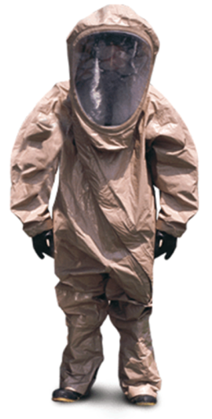
Level A Equipment
Fully encapsulating chemical resistant suit
Inhalation Hazard
Skin Hazard
SCBA
Gloves, chemical resistant
Outer
Inner
Boots
chemical resistant
Hard hat (under suit)
Highest Level of Protection

Slide 7
Level B (Liquid Splash Protection)
The same level of respiratory protection is required as in Level A. However, a lesser degree of skin protection is needed than for Level A.
SCBA
Level B protection allows for certain areas of exposed skin on the wearer.
Level B protective clothing would include either a one piece or two-piece ensemble with the SCBA worn outside the garment. Separate gloves and boots would be "taped" or "sealed" at the interfaces to minimize chemical penetration. The trend now is to use encapsulating garments that are not "vapor tight" as Level B garments.
Chemicals that are known and NOT to be vapors or gases that are toxic by skin absorption, or are carcinogenic.
Exposure situations will typically be at lower chemical concentrations (below established exposure limits).

Slide 8
Level B Equipment
Gloves, chemical resistant
Outer
Inner
Chemical resistant clothing
Coverall, splash suits, one or two piece
Boots (outer) chemical resistant
Booties
SCBA
Hard hat
Face shield

Slide 9
Level C (Particle or Liquid Splash Protection)
The same level of skin protection as Level B, but a lower level of respiratory protection is needed (i.e. air purifying respirators).
APR
One or two piece splash suits are worn with a cartridge respirator.
Protective Clothing May or May Not Be Required
Chemicals are not hazardous via skin absorption and are typically well below established exposure limits

Slide 10
Level C Equipment
Air purifying respirator
Full-face or half-mask, (NIOSH approved)
Chemical resistant clothing
splash suit, one or two piece.
Gloves, chemical resistant.
Outer
Inner
Boots, outer, chemical resistant

Slide 11
Level D (No Hazard Protection)
No respiratory protection and very little skin protection is needed.
Coveralls and general safety gear (ie. shoes, gloves, eye, head wear) are worn.
The work environment has no possibility for contact with hazardous chemicals. (The workers do not expect to come in contact with chemicals)

Slide 12
Level D Equipment
Coveralls
Boots/shoes
leather or chemical resistant
Misc. (i.e. head, eyewear, hearing protection, etc.)

Slide 13
PPE Limitations
Affects Mobility
Hazard Around Machinery
Heat Stress
Work-Rest Cycle
Drink Fluids (8 oz. of Water) Every 30 Minutes
Shaded Work/Rest Area
Biological Monitoring (Heart Rate)
Administrative Controls

Slide 14
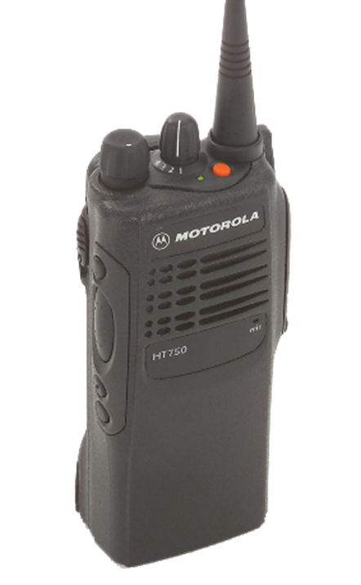
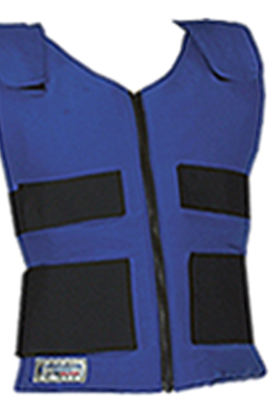
Donning
When ambient temperature is 70 degrees and above a cool vest shall be donned.
Place all ice packs in vest
Ice packs located in fridge in each trailer
Select Radio
Turn to appropriate channel for entry
Don earpiece
Don throat mic
Test radio

Slide 15
Donning Suits and Boots
Select boot appropriate for product
Tingley
Select appropriate suit for product
Be sure to check suits limits for specific chemicals
Have a helper assist with donning of respiratory protection
SCBA
Gloves – ask research for appropriate glove selection
Inner & Outer
Tape seams

Slide 16
Paperwork/Forms
What do I need to fill out?

Slide 17
Donning Checklist
This checklist should be filled out by a support or ops personnel each time a Technician is to make entry.
The checklist can be found in the trailers on a clip board.

Slide 18
Medical Evaluation Form
This form must be filled out completely prior to and after entry.

Slide 19
Scenarios
Put your thinking caps on

Slide 20
Scenarios
Please review the scenarios and consider the following:
Based on the incident provided, what are your concerns?
(i.e. waterways, rail, residential, school etc)
What Level PPE should be worn?
A, B, C or D
Is there an identifiable chemical? Are they Identifiable by placard?
Would you use any metering equipment or papers?
If so, what instruments?

Slide 21
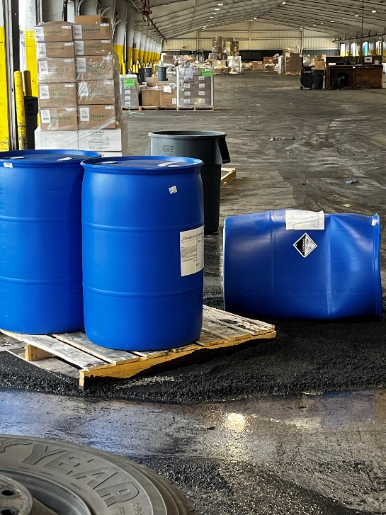
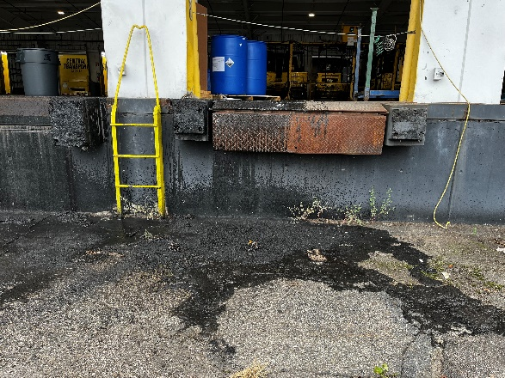
Scenario 1

Slide 22
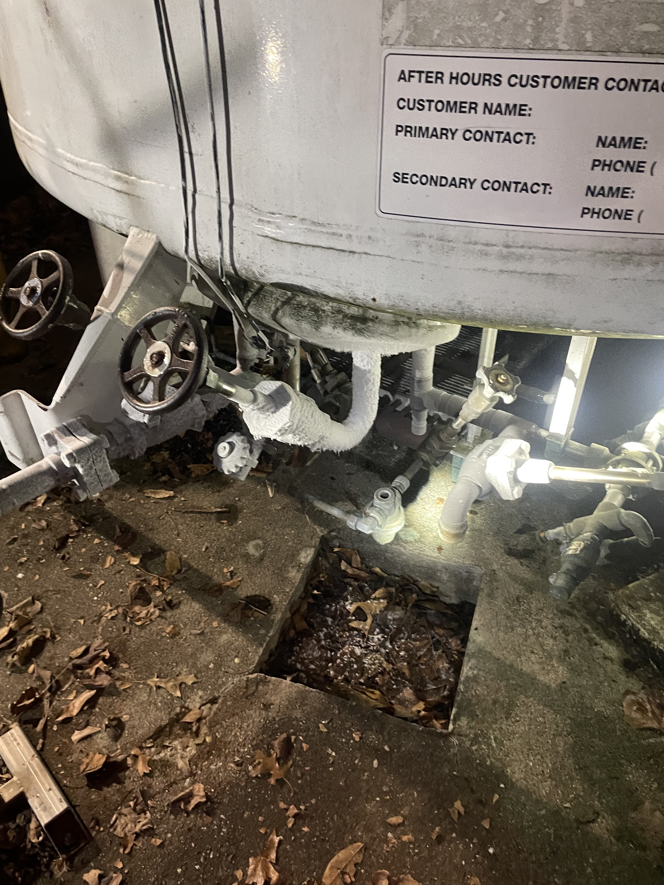
Scenario 2

Slide 23
Scenario 3
https://www.tiktok.com/@cleaningmamabee/video/7011671416248618245?is_from_webapp=1&sender_device=pc&web_id=7272807049557755434

Slide 24
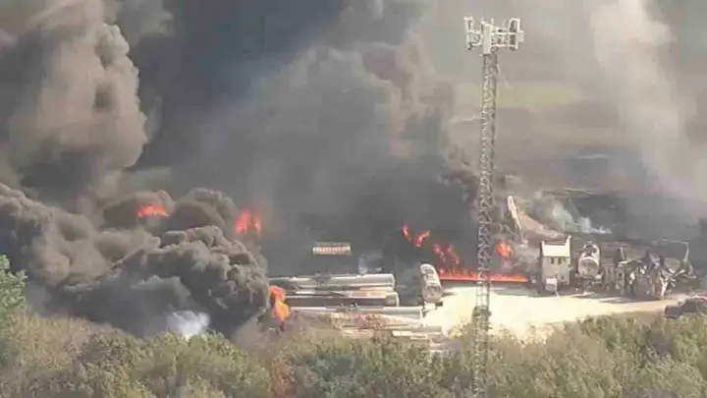
Scenario 4

