Slide 1
Greater Cincinnati Hazmat Unit

Slide 2
About us
We are governed by a Board of Trustees representing the fire service, the public, local government, and tri state businesses. Members are from the fire service, public service organizations and are industrial/government technical personnel.
The Unit is a verified Type 1 Hazmat response team as defined by the State of Ohio Hazmat Technical Advisory Guidelines. This is the highest level of typing for a Hazmat team in the State of Ohio.

Slide 3
Operations
GCHMU has 3 part time Duty Officers
Ret. Chief Don Bennett
Chief B.J Jetter
Dennis Waldbillig
1 Office Administrator
Brooke Matzen
Membership is comprised of Technicians, Specialists, Research and Operations personnel

Slide 4
Response Area
Ohio
Clermont County
Clinton County
Hamilton County
Warren County
Indiana
Dearborn County
Franklin County
Ripley County
Ohio County

Slide 5
Response Services
Administrative Consultation
Administrative Response
Full Team Response
We are not going to take over any incident. We are a tool in your toolbox. Our job is to support you.

Slide 6
Administrative Consultation
The on-call duty officer will call the incident commander at the number given to the communications center upon receipt of call.
1
*Be sure to give a good call back number *
Don’t give your office line if you are in the field.
2
The duty officer will provide information such as if a clean up contractor is needed, advice on clean up, reassurance on what your doing, contact with a chemist or EPA On Scene Coordinator.
3

Slide 7
Administrative Response
A duty officer responds to the scene and provides expertise in mitigation.
A chemist or other specialty personnel may be called upon.

Slide 8
Full Team Response
A response that includes a duty officer(s), chemists, technicians and apparatus.
Examples of apparatus include:
Analytical Response Unit
Truck/Trailer Combo
Absorbent Trailer

Slide 9
Dispatch: When asking dispatch, please ask for Greater Cincinnati Hazmat Unit.
The unit is dispatched through Hamilton County Communications Center 513-825-2260
The Unit must be requested by the Police/Fire Department Incident Commander

Slide 10
What we need from the requesting agency
A staging location for our personnel to meet and set up
Our team members arrive in POV’s so we need sufficient parking.
A fire ground we can talk to units on while enroute
We have our own comms when working on scene. Duty Officer needs FG to talk to the IC
Assistance with setting up Decon line upon arrival on scene
We ask the local fire agency to assist with this. We will provide a Decon Coordinator.
Any information pertaining to release- placard, color, plume, smells etc
If you can send a picture via text or email

Slide 11
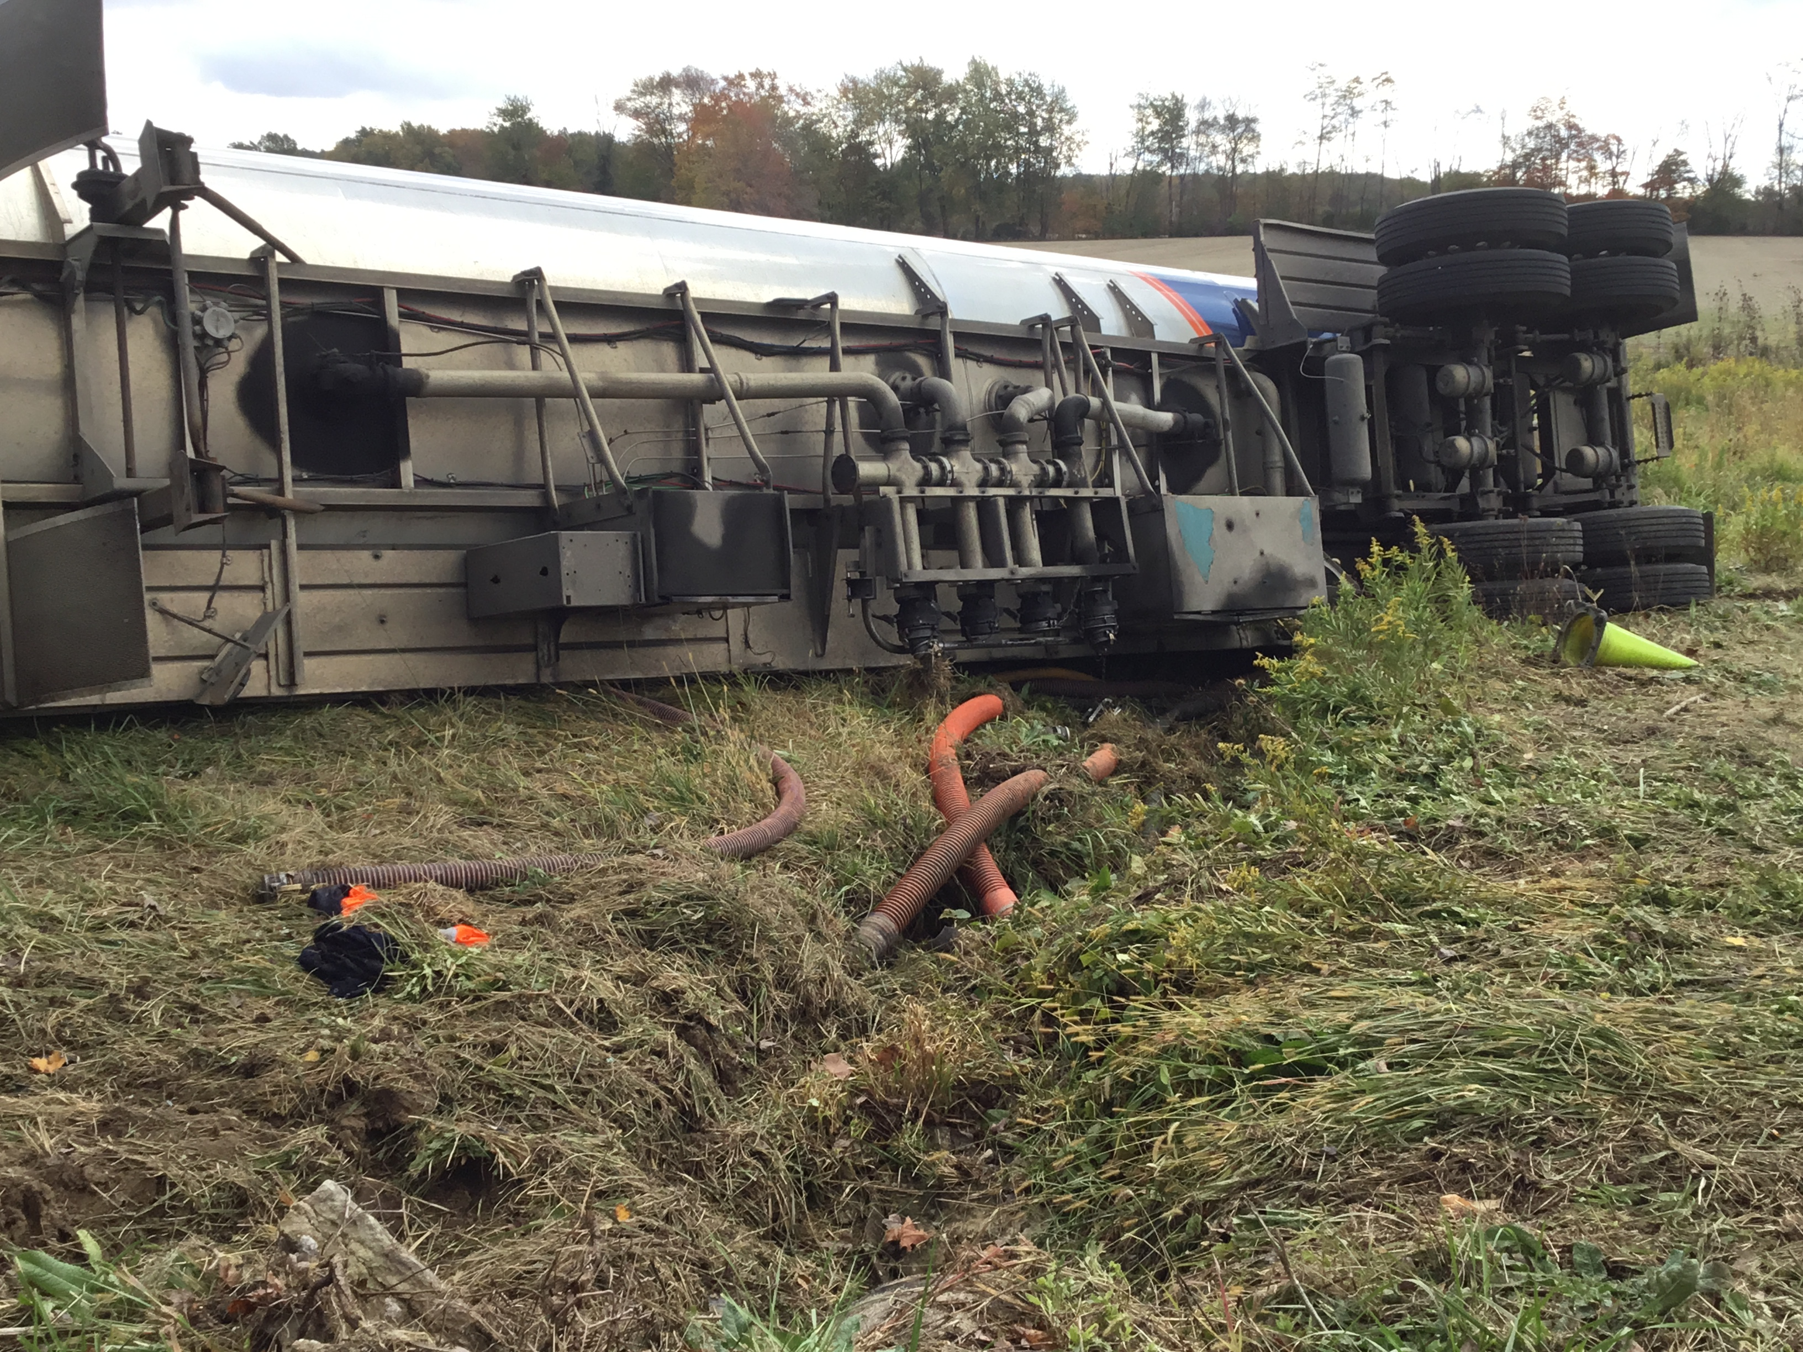
Hazmat Resources

Slide 12
Hazmat Response Units
Truck and Trailer Combos
Analytical Van
Foam Truck
City of Sharonville, Ohio
Absorbent Trailer
City of Sharonville, Ohio
City of Sharonville, Ohio
City of Sharonville, Ohio
Deerfield Twp, Ohio
Mobile Command Van
City of Sharonville, Ohio

Slide 13
Contact Info
1881 E Crescentville Road
Office 513-779-1200
Fax 513-779-0703
www.gchmu.org
Brooke Matzen – Office Administrator
Brmatzen@gmail.com

Slide 14
Placards

Slide 17
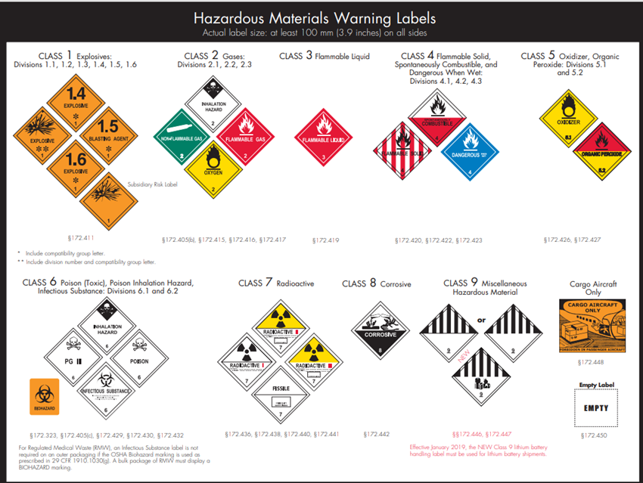
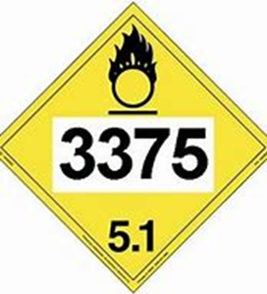
What is a UN Number? A UN Number is a 4-digit number that identifies Hazardous Materials such as explosives, flammable liquids, oxidizers and some acutely toxic substances

Slide 18
Emergency Response Guidebook (ERG)
New additions due out March 2024
*Changes/Additions for 2024
Adding a QR code to reporting incidents
Adding information for electric vehicles
Expanding several guides, including 115 and 140
Updating the Marking, Labeling, and Placard ID charts located in the front of the ERG
Giving first aid guidance and chem warfare/biological agents their own sections
Adding/Removing several UN/ID numbers from the ERG to harmonize with the HMR (Hazardous Materials Regulations)

Slide 19
What are the ERG section colors and what do they mean?
The ERG is divided into five colored sections, which help you easily navigate through the pages and identify safety procedures when you are looking for information. The colored sections include:
All white pages, found in the front and back of the ERG, provide information for:
Instructions on how to use the ERG
General safety precautions
Notification and request for technical information
Hazard classification
Identification charts for markings, labels, placards, cargo tanks, and rail cars
Fire and spill control measures
Yellow bordered pages are arranged in order by UN or ID number and provide the guide numbers for the material.
Blue bordered pages are arranged in order by proper shipping name and provide the guide numbers for the material.

Slide 20
What are the ERG section colors and what do they mean?
Orange bordered pages include the actual response guides. Each of the guides provides safety recommendations and directions on how to proceed during the initial response phase of the incident. The guides provide information for:
Fire or explosion risks
Health
Protective clothing needed
Evacuation
Fire mitigation
Spill or leaks
First aid measures
Green bordered pages provide initial evacuation or shelter in place distances (protective action distances) for spills of materials that are Toxic-by-Inhalation (TIH).

Slide 21
Safety Data Sheets (SDS) or Material Safety Data Sheets (MSDS)
A safety data sheet (SDS) is an important document that the US Occupational Safety and Health Administration (OSHA) requires employers to make available to employees for any potentially harmful substances that may be handled in the workplace. Any business or driver should have the SDS printed and readily available if hauling any product or have any product onsite for 24 hours or more.

Slide 22
In the US, a SDS will follow a standard format, divided into the following sections:
Section 1: Identification
Section 2: Hazard(s) identification
Section 3: Composition/information on ingredients
Section 4: First aid measures
Section 5: Firefighting measures
Section 6: Accidental release measures
Section 7: Handling and storage
Section 8: Exposure controls/personal protection
Section 9: Physical and chemical properties
Section 10: Stability and reactivity
Section 11: Toxicological information
Section 12: Ecological information
Section 13: Disposal considerations
Section 14: Transportation information
Section 15: Regulatory information
Section 16: Other information

Slide 23
There is valuable information in each section of an SDS. However, while any user should always read the entire SDS, the most critical information for your health and safety can be found in:
Section 2: Hazard identification
Section 4: First aid measures
Section 7: Handling and storage
Section 8: Exposure controls/personal protection
These sections contain the information you need to be informed of the risks, and to make sure you do not suffer an injury while using the product.

Slide 24
Hazard identification:
The section on hazard identification can be the most confusing, but it is also the most important to understand. The top of the section is often a sub-section titled GHS classification, with a list of hazard types followed by a number. The hazards listed in this section will be only those specific to this particular material, but are drawn from a longer list of potential hazards, which are sometimes divided by health hazards, physical hazards, and hazards not otherwise classified.

Slide 25
Section 2:

Slide 26
GHS Classification:
In general terms, in the GHS system, a lower number means a higher risk, while a higher number means a decreasing, but still present risk.

Slide 27
Section 4: First Aid Measures

Slide 28
Section 8: Exposure/ Personal Protection

Slide 29
Section 9: Physical and Chemical Properties

Slide 30
Sections 13-16

