Slide 1
Greater Cincinnati Hazmat Unit

Slide 2
About us
We are governed by a Board of Trustees representing the fire service, the public, local government, and tri state businesses. Members are from the fire service, public service organizations and are industrial/government technical personnel.
The Unit is a verified Type 1 Hazmat response team as defined by the State of Ohio Hazmat Technical Advisory Guidelines. This is the highest level of typing for a Hazmat team in the State of Ohio.

Slide 3
Operations
GCHMU has 3 part time Duty Officers
Chief Don Bennett
Chief B.J Jetter
Dennis Waldbillig
1 Office Administrator
Brooke Matzen
Membership is comprised of Technicians, Specialists, Research and Operations personnel

Slide 4
Response Area
Ohio
Clermont County
Clinton County
Hamilton County
Warren County
Indiana
Dearborn County
Franklin County
Ripley County
Ohio County

Slide 5
Response Services
Administrative Consultation
Administrative Response
Full Team Response
We are not going to take over any incident. We are a tool in your toolbox. Our job is to support you.

Slide 6
Administrative Consultation
The on-call duty officer will call the incident commander at the number given to the communications center upon receipt of call.
1
*Be sure to give a good call back number *
Don’t give your office line if you are in the field.
2
The duty officer will provide information such as if a clean up contractor is needed, advice on clean up, reassurance on what your doing, contact with a chemist or EPA On Scene Coordinator.
3

Slide 7
Administrative Response
A duty officer responds to the scene and provides expertise in mitigation.
A chemist or other specialty personnel may be called upon.

Slide 8
Full Team Response
A response that includes a duty officer(s), chemists, technicians and apparatus.
Examples of apparatus include:
Analytical Response Unit
Truck/Trailer Combo
Absorbent Trailer

Slide 9
Dispatch: When asking dispatch, please ask for Greater Cincinnati Hazmat Unit.
The unit is dispatched through Hamilton County Communications Center 513-825-2260
The Unit must be requested by the Police/Fire Department Incident Commander

Slide 10
What we need from the requesting agency
A staging location for our personnel to meet and set up
Our team members arrive in POV’s so we need sufficient parking.
A fire ground we can talk to units on while enroute
We have our own comms when working on scene. Duty Officer needs FG to talk to the IC
Assistance with setting up Decon line upon arrival on scene
We ask the local fire agency to assist with this. We will provide a Decon Coordinator.
Any information pertaining to release- placard, color, plume, smells etc
If you can send a picture via text or email

Slide 11
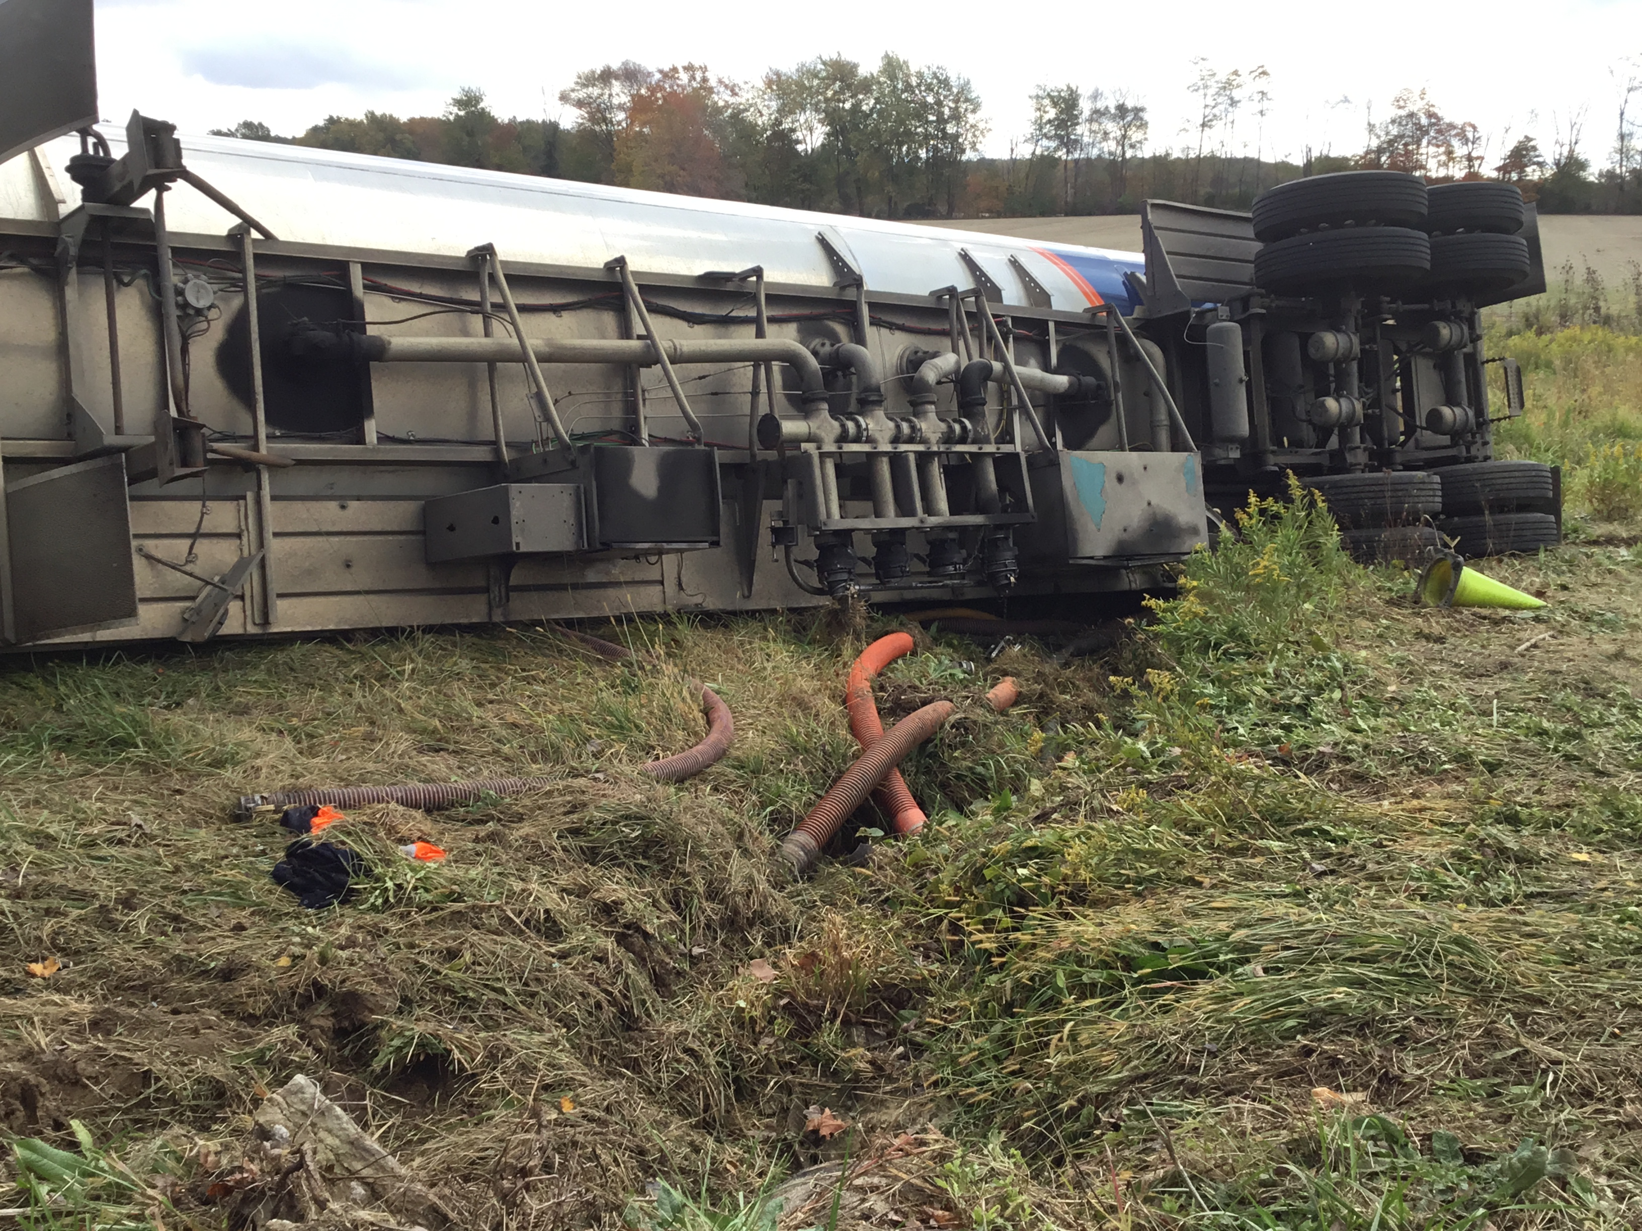
Hazmat Resources

Slide 12
Hazmat Units
Truck and Trailer Combo
Analytical Van
Absorbent Trailer
City of Sharonville, Ohio
Deerfield Twp, Ohio
Mobile Command Van
City of Sharonville, Ohio
City of Sharonville, Ohio
City of Fairfield, Ohio
Foam Truck
City of Fairfield, Ohio

Slide 13
Contact Info
1881 E Crescentville Road
Office 513-779-1200
Fax 513-779-0703
www.gchmu.org
Brooke Matzen – Office Administrator
Brmatzen@gmail.com

