Slide 1
Drager Tubes & MagnaSeal
3.09.2024

Slide 2
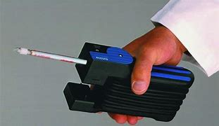
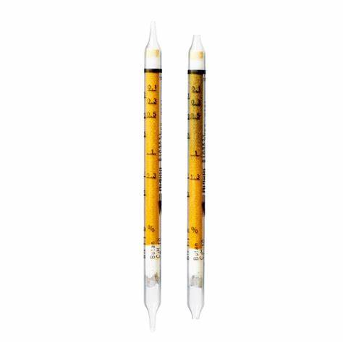
Drager Tubes
What are they?
How to use
Where are they?
What do we have?

Slide 3
What are Drager Tubes?
Drager Tubes are direct reading colorimetric indication tubes used to measure different gasses and vapors.
There are approximately 500 different substances that can be measured.
They are single use only.
They are used for determination of concentration peaks, measurements of exposures in inhalation area and the determination of possible leakages.

Slide 4
READ BEFORE YOU PUMP
Almost all information pertaining to the tube can be found on the exterior of the package.
All drager tubes MUST be kept in original packaging
No SDS is required
Drager App has lots of good info

Slide 5
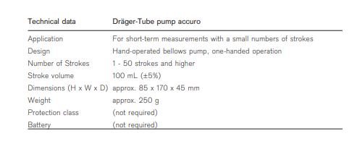
Drager Accuro Pump
Used in combination with Drager tubes.
Hand operated pump
Can be used in areas of explosion hazard since there is no external energy source

Slide 6
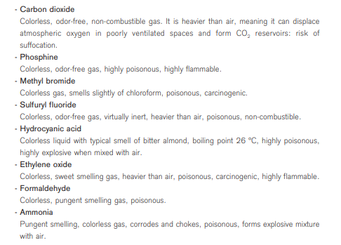
When can I use Drager tubes? fumigants
Fumigants are highly toxic and can be harmful to health in many ways.
Don’t forget to measure oxygen concentration.
Many different applications exist for fumigants
Fumigation of storage areas for food
Fumigation of containers for transportation of goods
Fumigation in the medical field for sterilization and disinfection

Slide 7
Drager Pump and tube use instructional video
https://youtu.be/8hFpw0_t_so?si=wJrvCaS3TI0jrgBF
Handbook for Drager Tubes and MicroTubes
https://www.draeger.com/Content/Documents/Content/tubes-and-cms-hb-9092086-en.pdf

Slide 8
All Drager tubes are located on the ARU What do we carry?
Ammonia 5/a Gas Detection Tube
Ammonia 5/b Gas Detection Tube
Hydrogen Fluoride 1.5/b Gas Detection Tube
Sulfur Dioxide 0.1/a Gas Detection Tube
Phosgene 0.02/a Gas Detection Tube
Phosphine 0.01/a Gas Detection Tube
Cyanide 2/a Gas Detection Tube
Sulfuric Acid 1/a Gas Detection Tube
Phenol 1/b Gas Detection Tube
Chlorine 0.2/a Gas Detection Tube
Hydrocarbons 2/a Gas Detection Tube

Slide 9
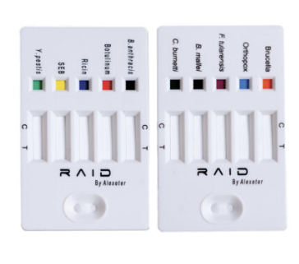
Coming soon! raid 10 multi agent detection kit
Immunoassay test strips
Detects: B. Anthracis, Ricin, Bot Tox, SEB, Plague, Brucella, Tularemia, Orthopox, Q Fever and Glanders

Slide 10
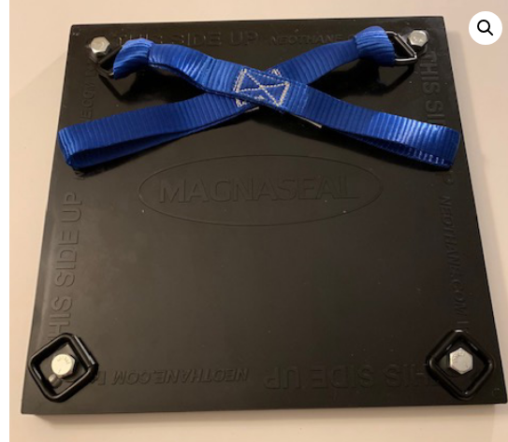
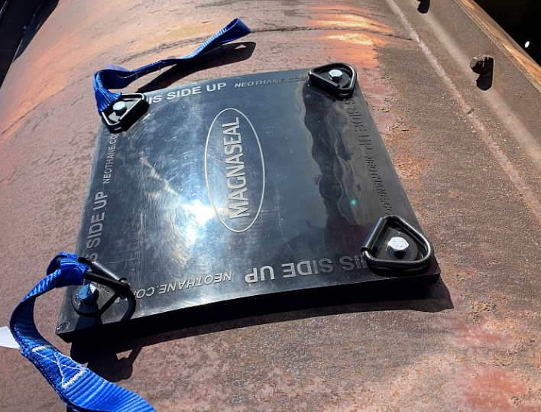
Magnaseal
High strength leak patch
About:
Magnetic, flexible, urethane patch
Can hold at minimum 30 lbs of pressure
Built in “D” rings and two 6-inch continuous loop webbing straps which can be used for installation
5/8 thickness
The corner “D” ring adds ¼ inch to thicknes
Patch Size: 12” X 12” X 5/8”
Box Size: 14” X 14” X 3”
Weight: 10lbs

Slide 11
MAGNASEAL Videos
https://youtu.be/GVDXbE7v93g?si=MA2Lf4haAKKnF9YF
See It In Action
https://youtu.be/tn0VGxx4Nc4?si=LYcFK90_Nx5R9jtE
Application and Removal

Slide 12
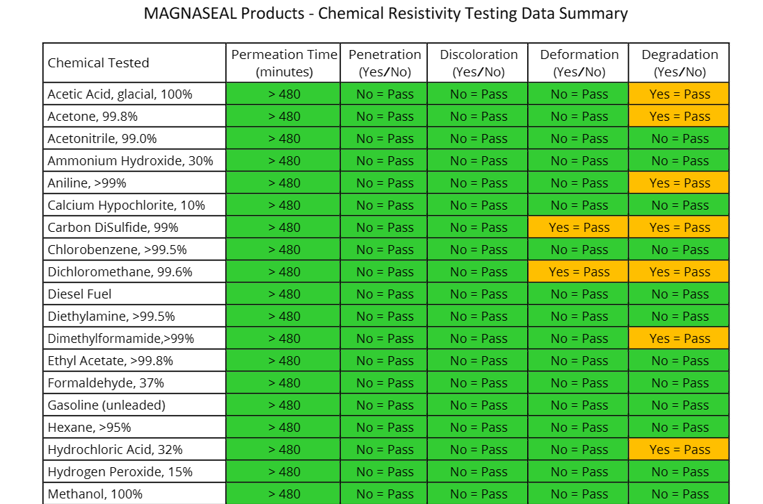

Slide 13
