Slide 1
2023 Year End Review 2024 Training opportunities

Slide 2
Hazmat Runs
1st Quarter:
January- April: 3 - Consultation – Lime, Admin Response – Unknown Substance, Admin Response – Nitrogen,
2nd Quarter:
May- August: 4 - Admin Response – Mixed Chemicals, Team Response – mixed commodities, Admin Consult – mixed cleaning solutions, Admin Response – unknown substance from tote
3rd Quarter:
September- December: 6 – Admin Response – Chemical Odor (x3), Admin Response – Methane, Admin Response – Electropolish EPS 4000, Admin Consult – Fire with paint
7 additional consults – Total 20 runs

Slide 3
Central Transport
EPS 4000 Electropolish (Sulfuric/Phosphoric acids)
55 gallon drum punctured, product spilled onto dock and concrete floor.
Fire department was not dispatched for hours after the spill. Personnel within the dock area continued to load and unload trucks all while walking through and driving machinery through the spilled product.
After several hours, personnel started to become ill and started having problems with their shoes. A worker who left the site and sought treatment reported the incident to the fire department.

Slide 4
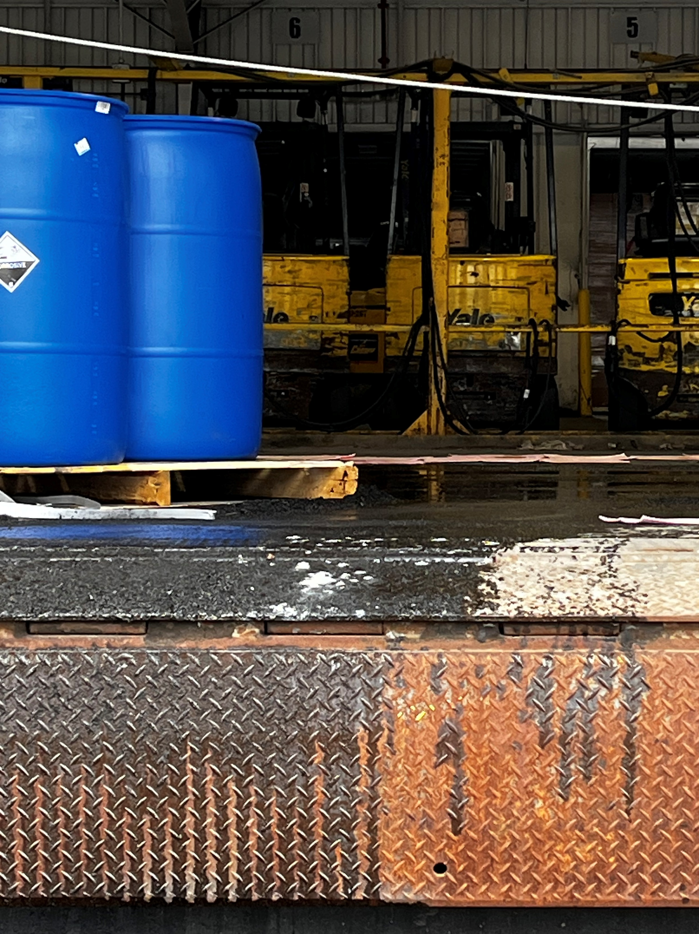
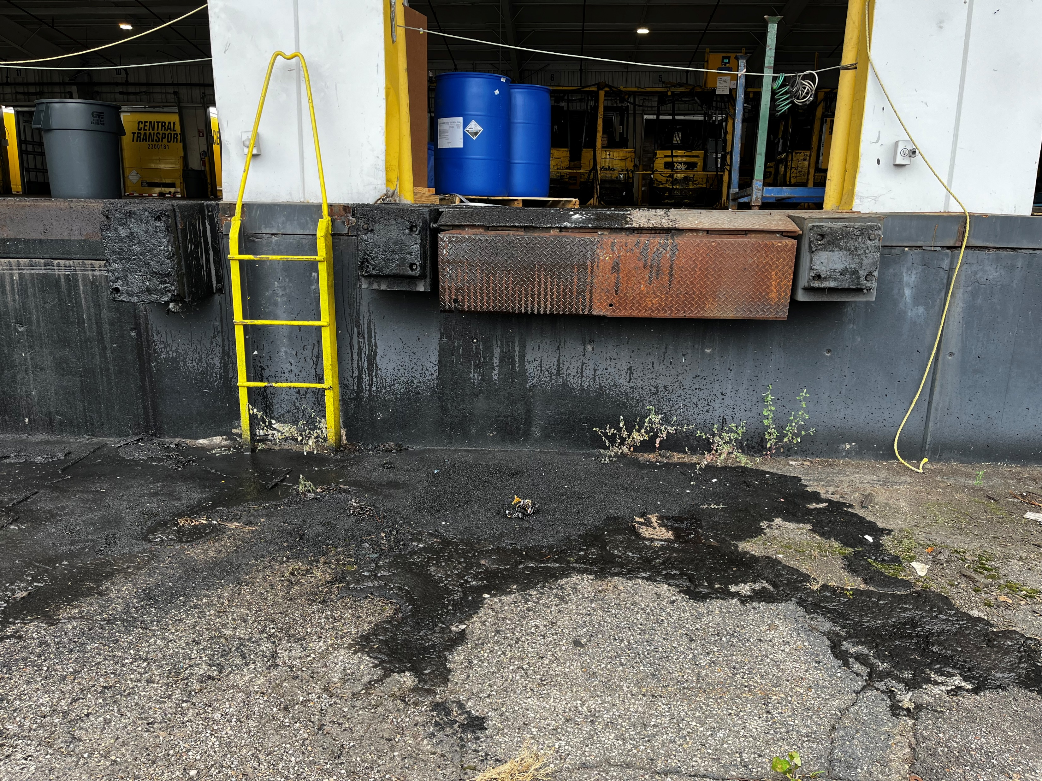
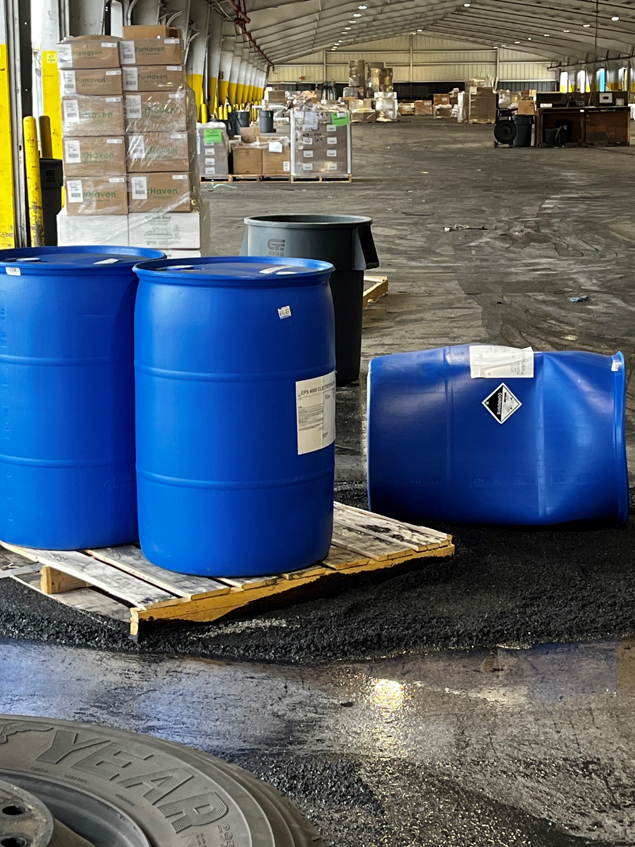

Slide 5
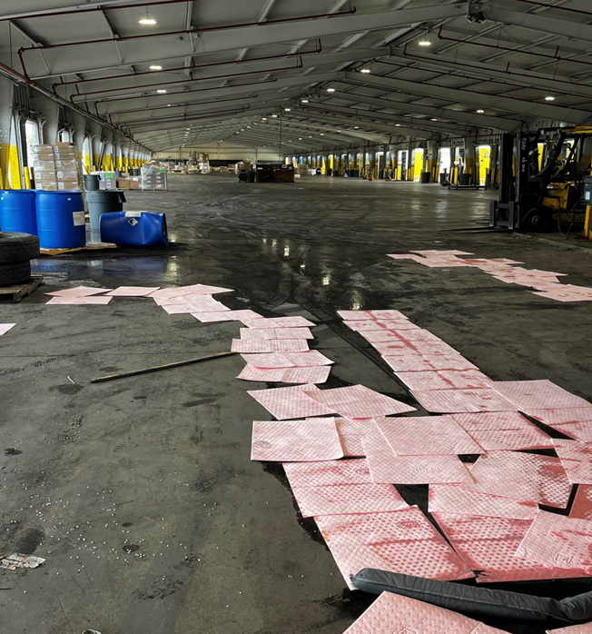
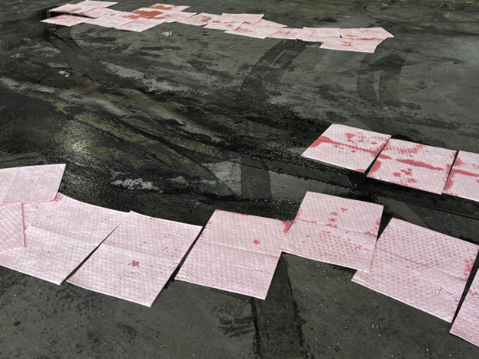

Slide 6
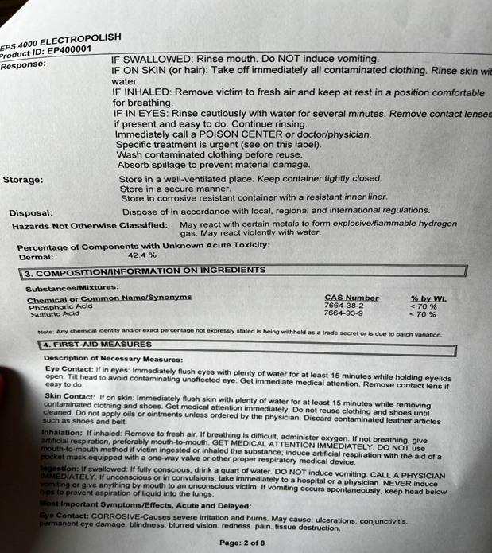
Safety Data Sheet

Slide 7
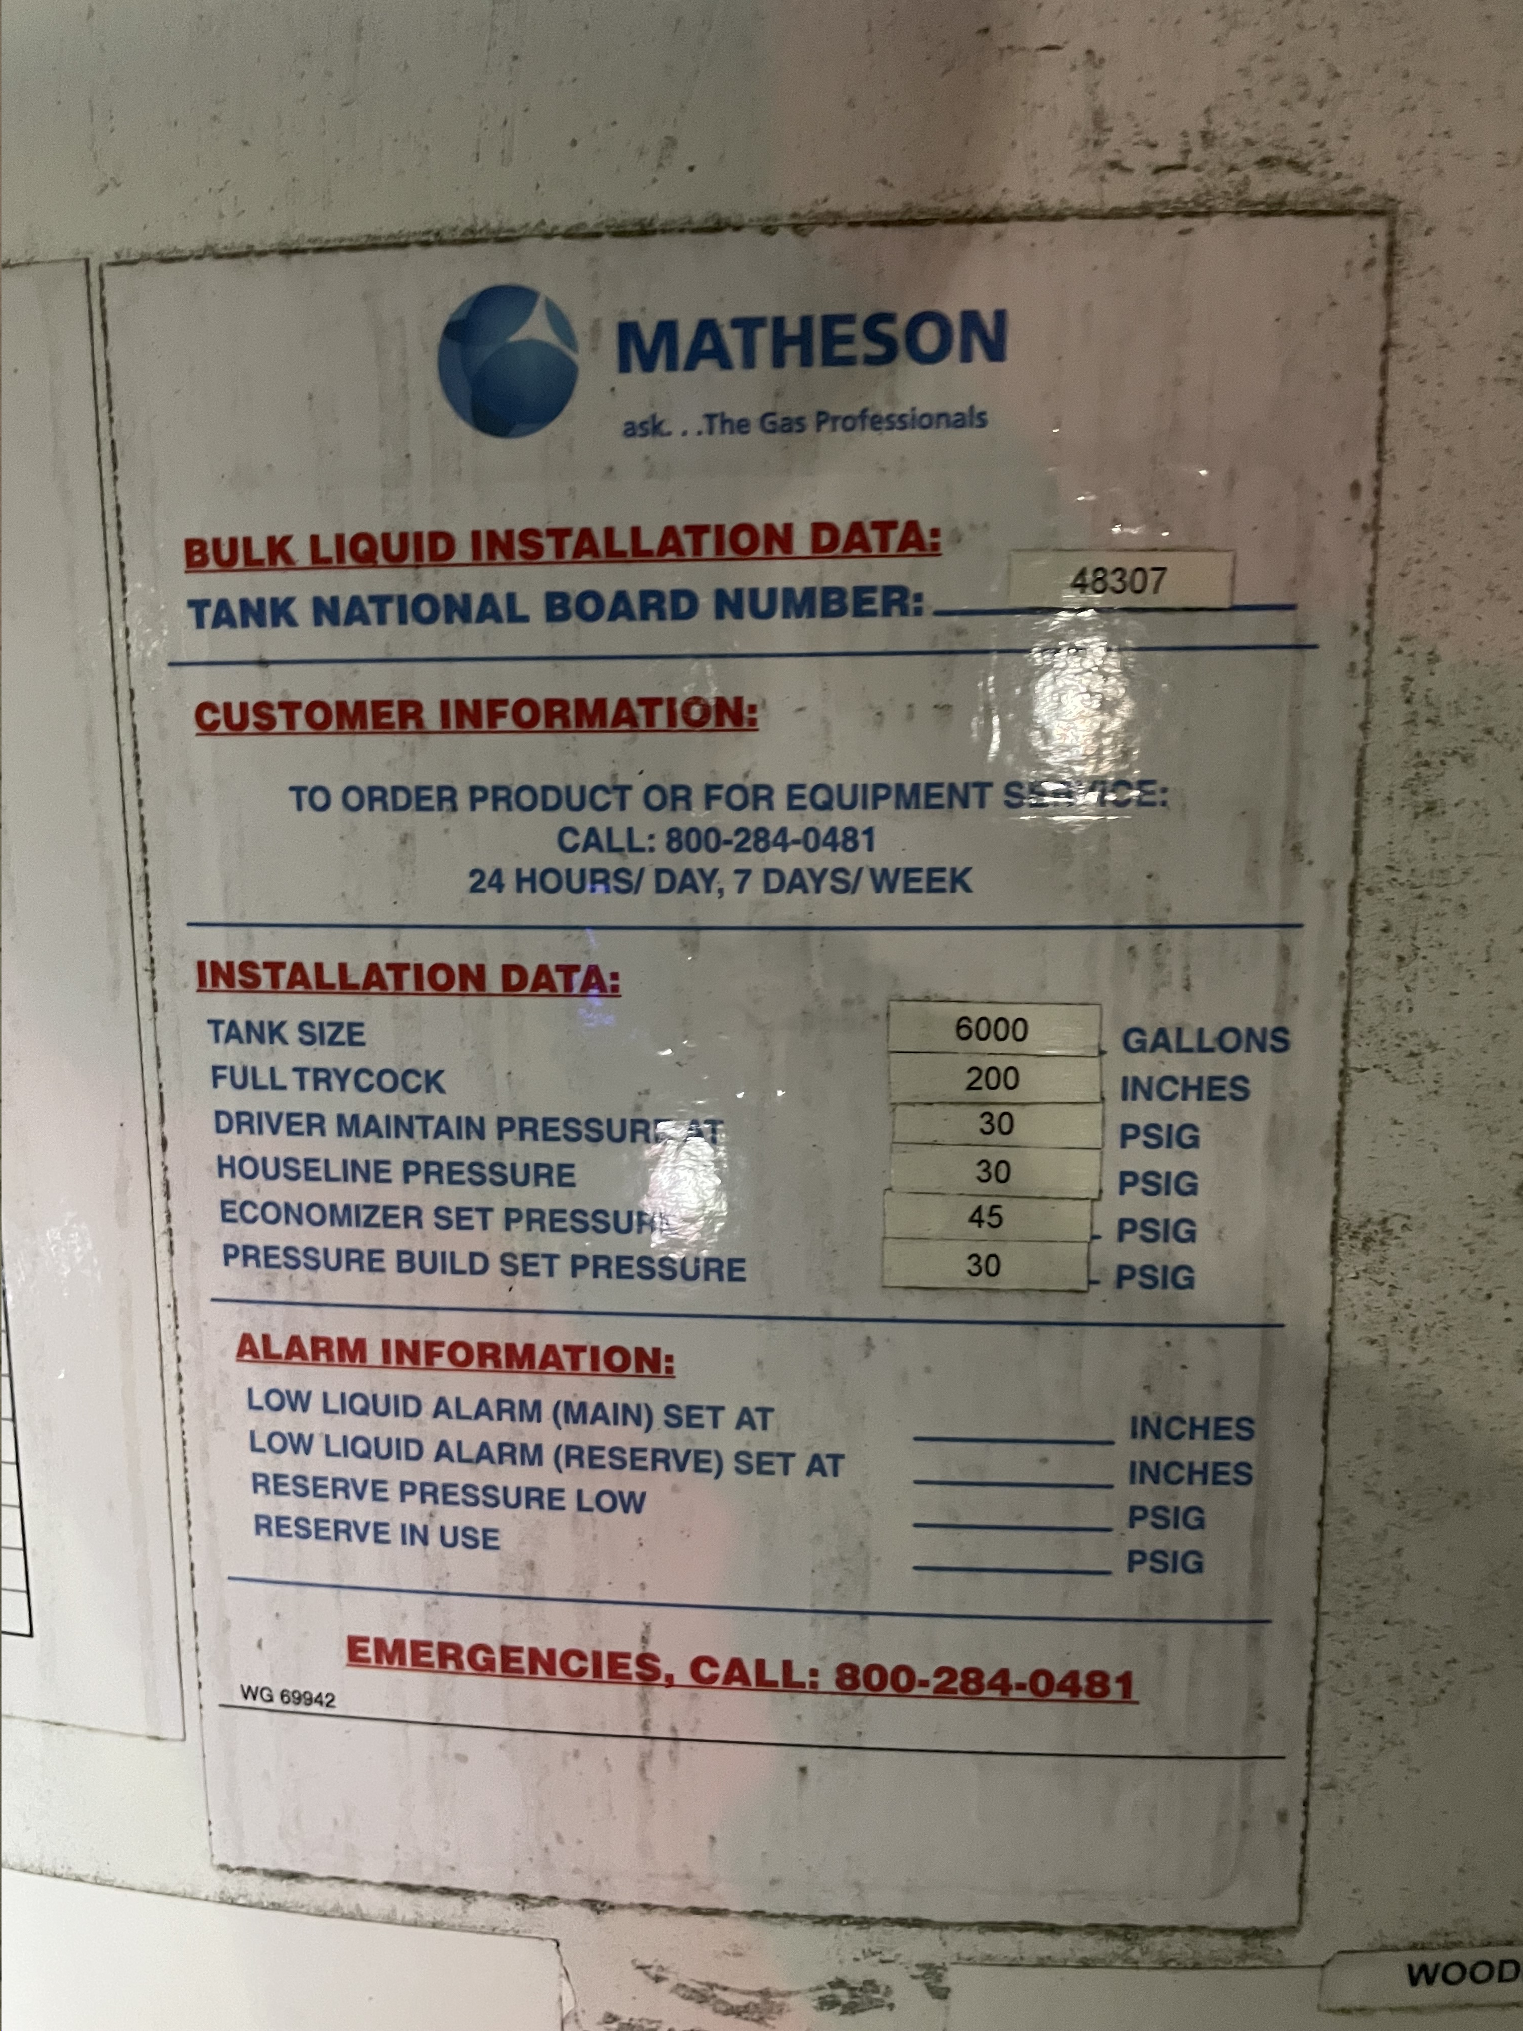
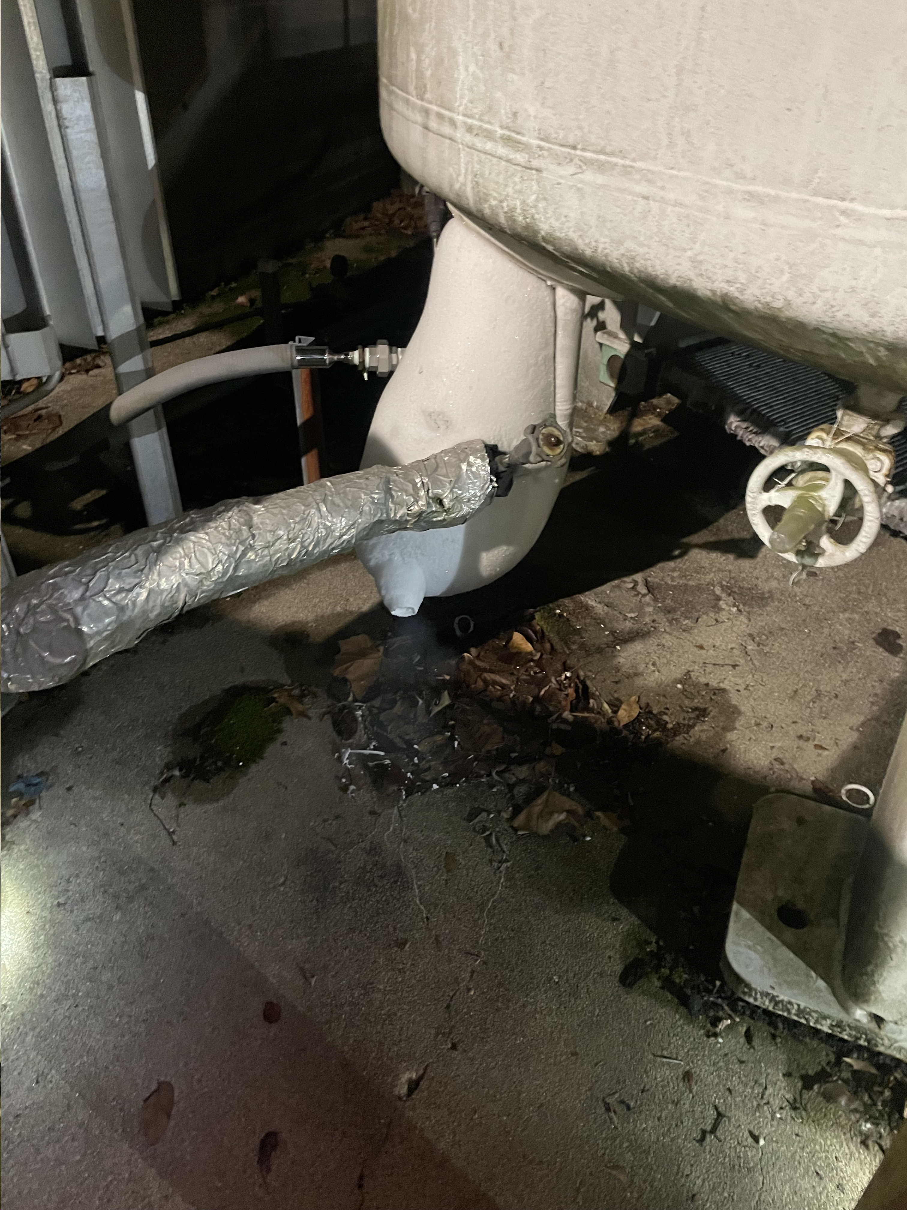
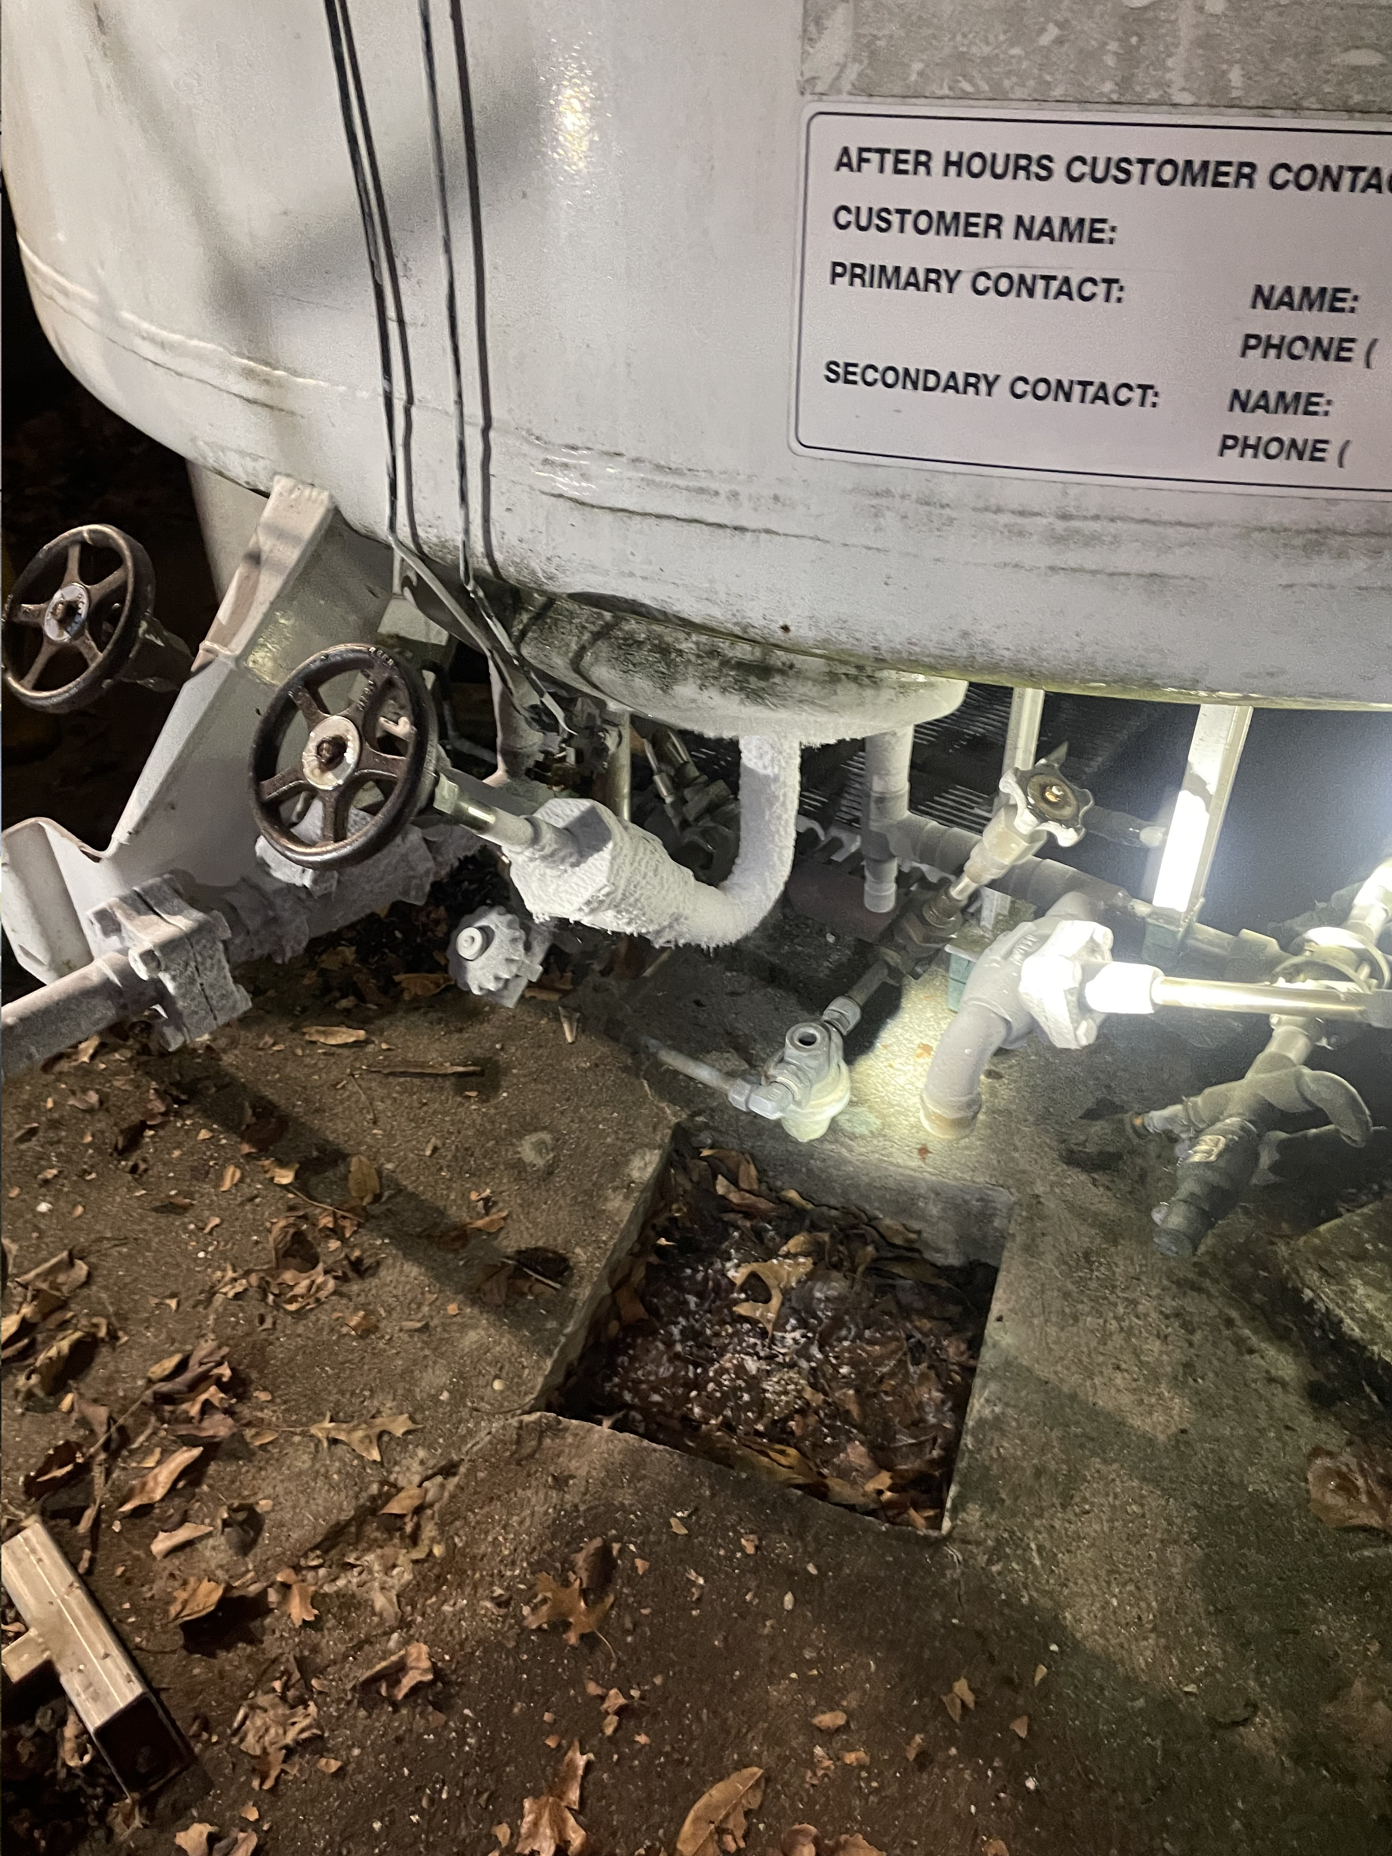
Woodlawn Rubber

Slide 8
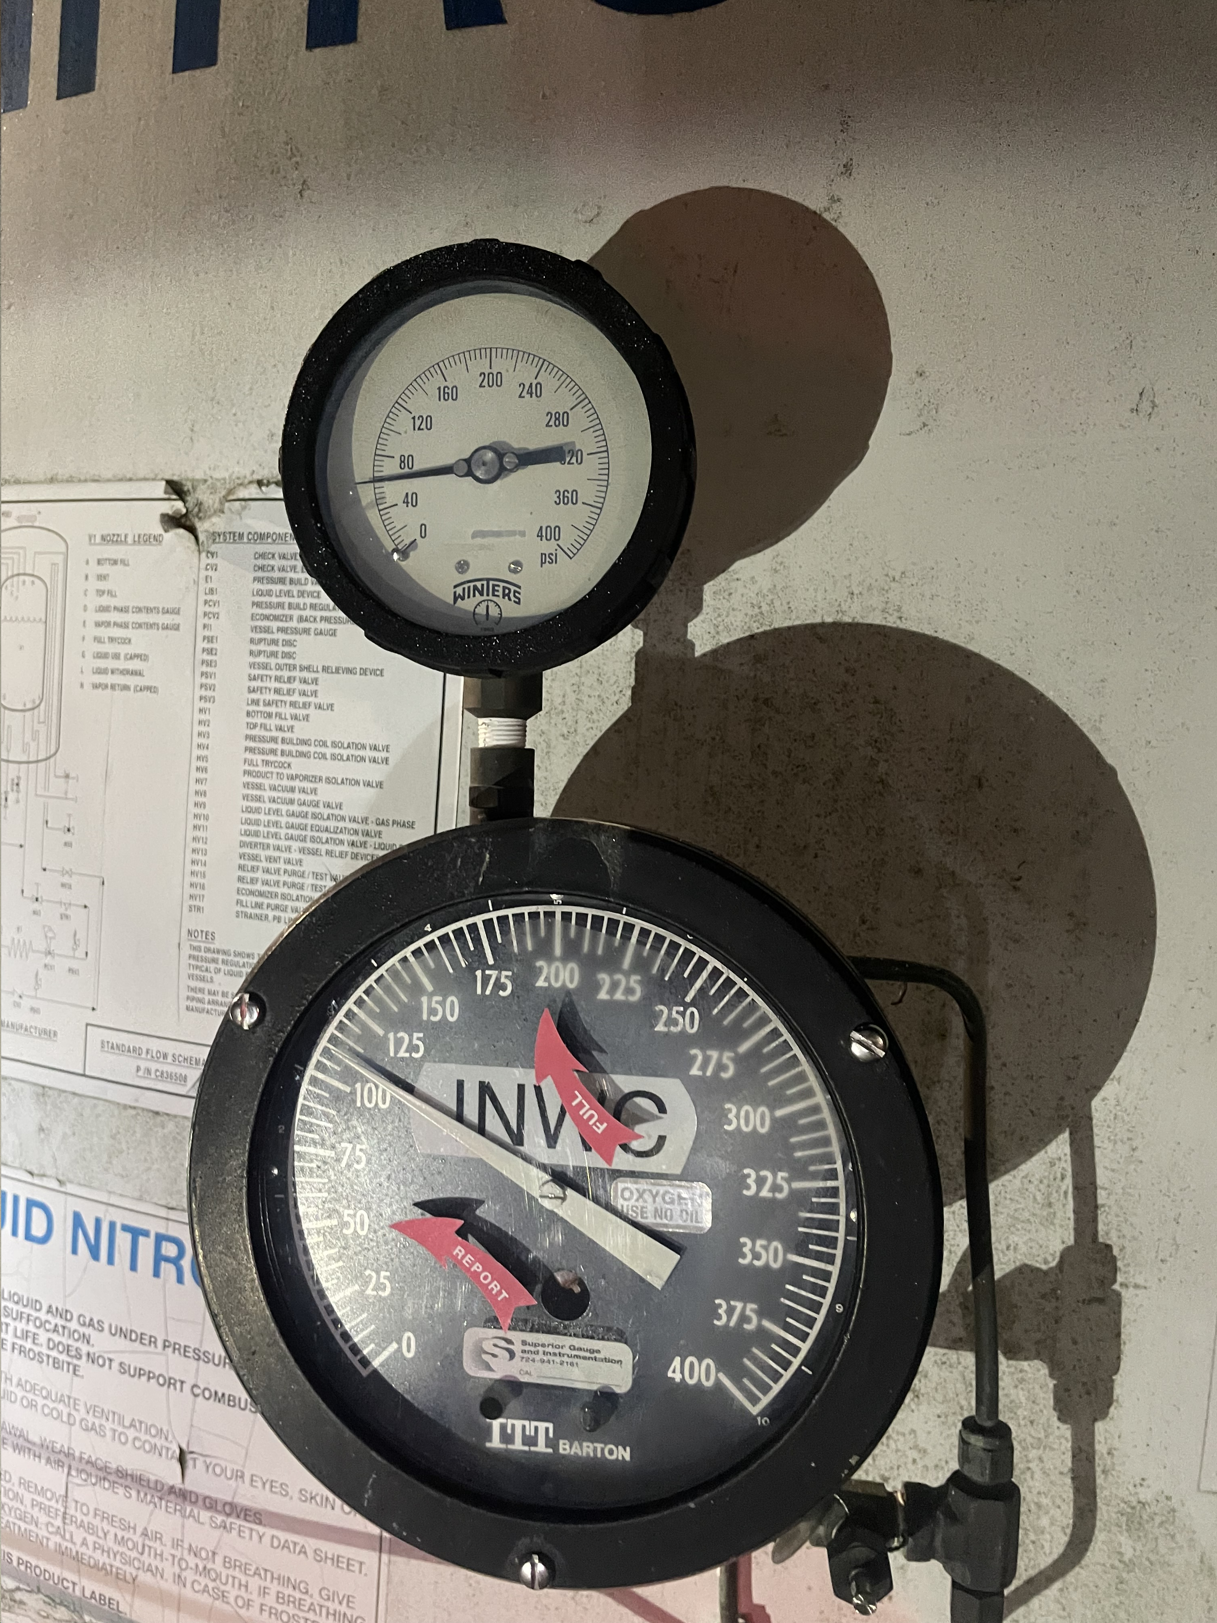
Woodlawn Rubber
Fire Dept received a call from a guest at a local hotel that she could hear a hissing noise coming from the liquid nitrogen tank at a business behind her room.
Upon inspection by the responding fire companies, a leak was discovered.
The District car made notification to the business owner who stated the tank normally off gasses.
After consulting with hazmat personnel and Matheson representatives, this is normal functions for the tank.
O2 levels were checked and remained at normal levels

Slide 9
Re Verification
HazMat team typing is used to verify that a State of Ohio HazMat team is capable of responding as part of the Ohio Fire Response Plan. A team is expected to be able to meet their requirements throughout the period of verification. If a team is not capable of meeting the requirements, they should contact the TAC and be removed from the Ohio Fire Response plan until the deficiency is addressed.
All verified Hazmat Teams are required to submit a re‐verification form annually. A team’s verification will expire on December 31st of each year unless the team has submitted a completed re‐verification form.
The administrative officer of each verified team shall acknowledge that the team still meets the requirements of their level of team typing by completing the application to re‐verify and submitting it to the Ohio HazMat TAC Chairman with a Copy to the Ohio EMA.
The Ohio EMA shall retain the records on behalf of the Ohio Hazmat TAC.
At least three Type 1 Teams shall be audited each year, and every Type 1 team shall be audited at least once every three years. The Teams to be audited will be announced at the January HazMat TAC meeting.
The audit shall consist of a site visit and verification of the same criteria as an initial verification visit, which shall include inspection of equipment, personnel records, training records and physical exam records.
Failure to complete the application, or failure to schedule the audit site visit when
selected, or failure to meet the criteria for re‐verification by December 31st shall result in
the team being removed as an available asset in the Ohio Fire Response Plan.

Slide 10
2024 Training
LEPC Sponsored
HazMat IQ – 1/25
HazMat Research Specialist – 2/27
Incident Response for Lithium Battery Emergencies – 3/6
Air Monitoring for Flammable Liquids and Gases – 5/9
CBRNE IQ – 5/23
Air Monitoring for Flammable Liquids and Gases – 8/27
HazMat IQ- 10/19
FOR COURSE FLYERS AND REGISTRATION INFORMATION GO TO:
https://www.hamiltoncountyohio.gov/emergency_management_agency/lepc

Slide 11
2024 LEPC Exercises/Agency Exercises
2/14 Regional Chemical Surge TTX
3/13 Warren County LEPC– TTX
5/9 Hamilton County/City of Cinti Functional Ex
Clermont County – TTX
Clinton County – Functional/FSE
Dearborn County – FSE

