Slide 1
Boom Deployment & Decon
July 2023

Slide 2
What is a boom?
Booms are floating, physical barriers to oil, made of plastic, metal or other materials, which slow the spread of oil and keep it contained.
Booms are commonly placed across a narrow entrance to close off that entrance so that oil can’t pass through.

Slide 3
3 main types of booms
Hard Boom:
a floating piece of plastic that has a cylindrical float at the top and is weighted at the bottom so that it has a “skirt” under the water.
Sorbent Boom:
Looks like a long sausage made out of material that absorbs oil.
Fire Boom:
Resembles metal plates with a floating metal cylinder at the top and thin metal plates that make the “skirt” in the water. This type of boom is made to contain oil long enough that it can be lit on fire and burned up.

Slide 5
Height: 18 inches Float Freeboard: 6 inches Skirt Draft: 12 inches Total tensile strength: 5,000lbs 6” diameter premium closed cell high density polyethylene rolled foam log Premium PVC coated polyester fabric with UV inhibitors
ABASCO Beta 1A – Hard Boom
18-inch Oil Containment Boom
Moderate to choppy water.
Used for containing or diverting oil on water
Ideal use:
Harbors
Rivers
Bays and Lagoons
Sheltered Water
Canals
Inland Waterways

Slide 9
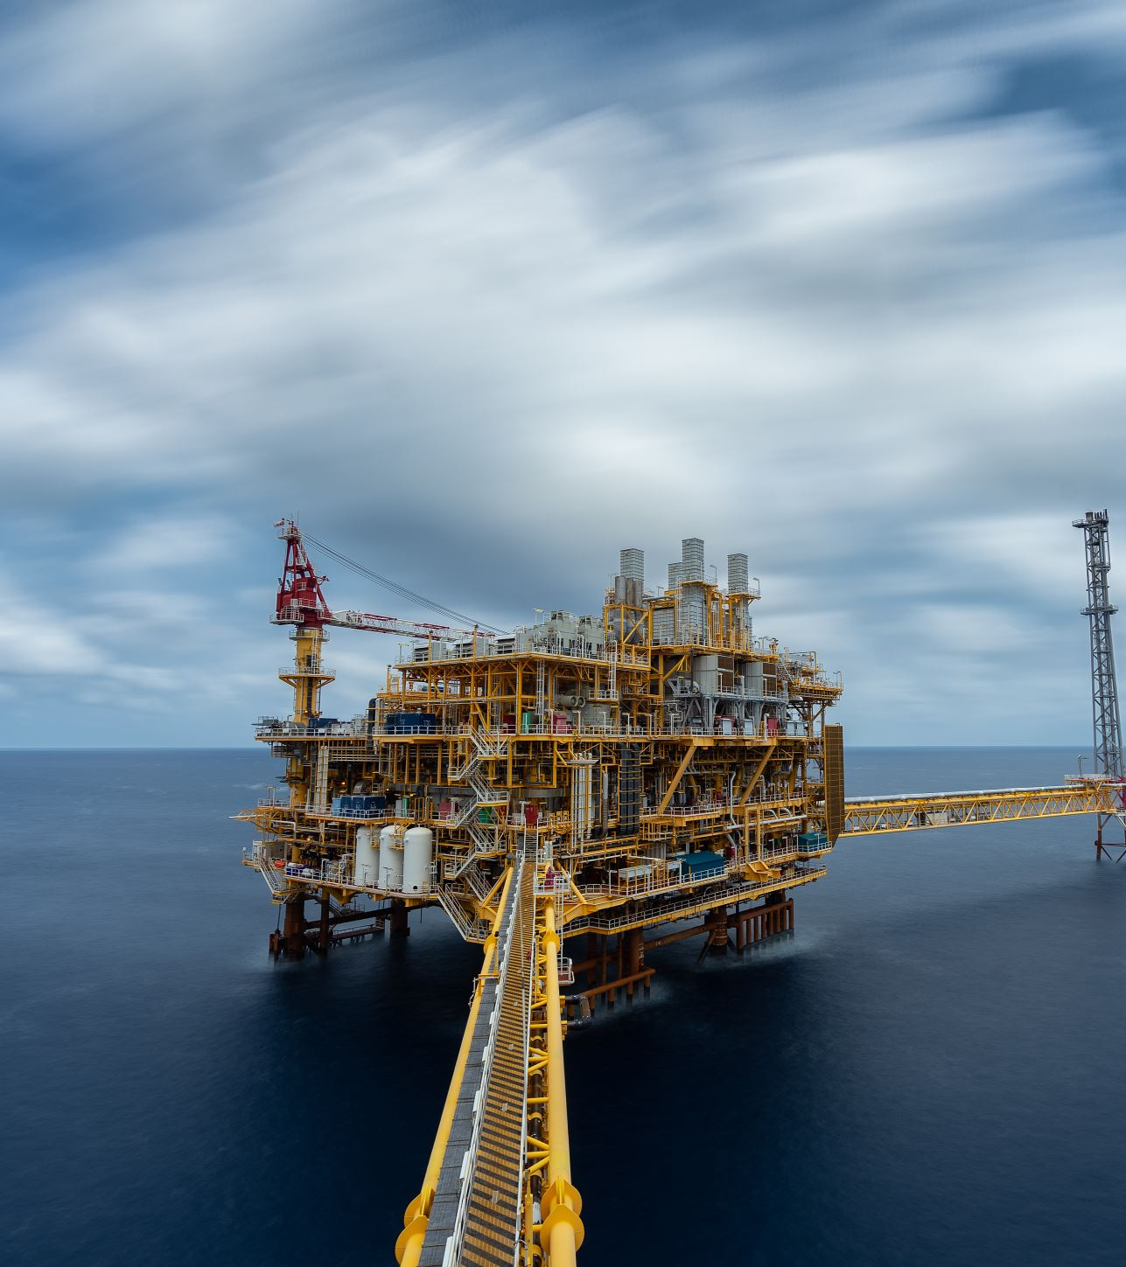
ABASCO SB510 Sorbent Boom
Oil Only Sorbent Booms (Polypropylene)
Dimensions: 5”x10’
Absorbency: 7.5 Gallons per boom
Provides containment and maximum adsorption while repelling water
Absorbs on land or water even raining
Will not sink when full saturated
Overlapping clips for deployment at any length
Embedded rope for easy deployment and retrieval

Slide 10
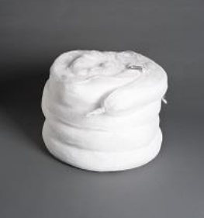
SB510 Sorbent Boom
Ideal use:
Wastewater troughs
Loading Docks
Ponds
Rivers
Oily spills

Slide 12
Decon
A Decon line shall be set up prior to deployment of booms in waterway
1
Always remember to fully decon any persons and reusable equipment that may come in contact with oil or contaminated waterways.
2
Should the equipment NOT be able to be deconned it must be disposed of
3

Slide 13
Let’s go deploy some booms!

