Slide 1
Spill Control
October 2024

Slide 2
Spill X
Spill X – A (Acid)
Acid neutralizing adsorbent neutralizes and solidifies most mineral and organic acids for safe and easy clean up.
Sulfuric, hydrochloric, nitric and hydrofluoric
Spill X - C (Caustic)
Caustic neutralizing adsorbent neutralizes and solidifies caustics for safe and easy cleanup.
Sodium hydroxide (50%) and ammonium hydroxide (29%)
Spill X - S (Solvent)
Solvent adsorbent adsorbs spills of many common hydrocarbon solvents, reagents and fuels.

Slide 3
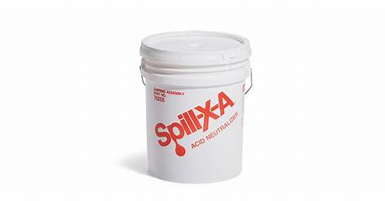
Qty 1, 5-gallon bucket will neutralize up to 4-6 gallons of product (either Spill X- A (acid) & C (caustic)) Qty 1, 5-Gallon bucket of Spill X-S (solvent) will neutralize up to 3 gallons of product Qty 1, 2lb container will neutralize ½ gallon.

Slide 4
Oil Only Spaghetti Booms BOM 203
5” x 10”
Absorbs and contain thick oils and other viscous liquids on water
Each boom absorbs up to 6 gallons
Zinc plated carbon steel attachment clips allows you to link booms together

Slide 5
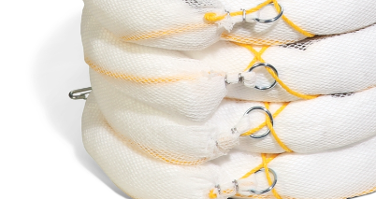
Oil Only Absorbent Boom BOM406
3” x 10”
Absorbs oil and fuel spills on water
Each boom absorbs up to 2 gallons
Can be clipped together

Slide 6
Oil Only Absorbent Socks SKM210
3”x 48”
Each sock absorbs up to 1 gallon
Oil spills on land but will float to clean up oil-based liquids on water
Can be tied down using the attached string.
Moldable to hug corners or contain puddles

Slide 7
Chemical Absorbent Sock 124CR
Absorbs small spills of concentrated chemicals including acids, bases or corrosives
Absorbs up to 100 ounces per sock
3” x 46”

Slide 8
Absorbent Pillows PIL201
Absorbs oil, coolants, solvents and water
Universal
Each pillow absorbs up to 2 gallons
17” x 21” 2”

Slide 9
Absorbent Mat Pad MAT240
Heavyweight
15” x 20”
100 pads per box
Absorbs oil, coolants, solvents and water

Slide 10
Oil Only Absorbent Mat MAT403
Heavyweight
15” x 20”
100 pads per bag
Absorbs oil and fules
Hates water

Slide 11
Hazmat Chemical Absorbent Mat Pad MAT301
Heavyweight
15” x 20”
100 pads per bag
Absorbs acids, bases and corrosives

Slide 12
Lite-Dri Loose Absorbent PLP201
Absorbs oil, coolants, solvents and water
Absorbs up to 8 gallons per bag
3X more absorbent than clay

