Slide 1
Hazmat Typing
Type 1
Required Equipment List Inventory

Slide 2
Ohio Hazardous Materials and WMD – Technical Advisory Committee
Every two years the verified hazmat teams must undergo a reverification visit to ensure they are maintaining equipment and completing their trainings as per the OG TAC guidelines.
This year we are making this a joint effort and asking membership for their assistance in making this happen. Each table number will have an assigned list of equipment they must identify on the designated vehicle.

Slide 3
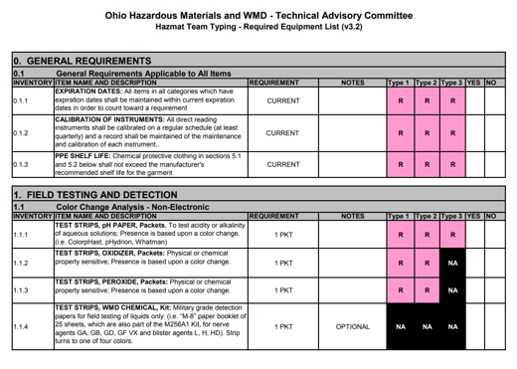
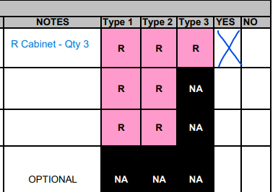
Agenda
Identify the required number
Mark Yes or No
In Notes- write the instrument that fulfills the request
Mark the location – cabinet, shelf etc

Slide 4
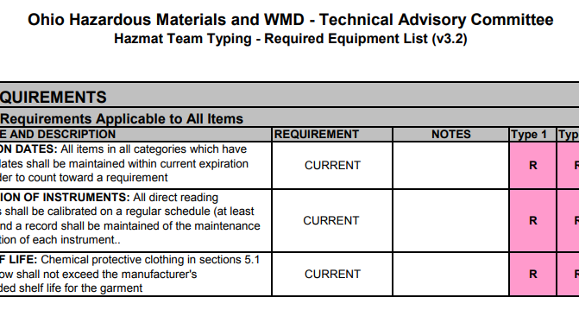
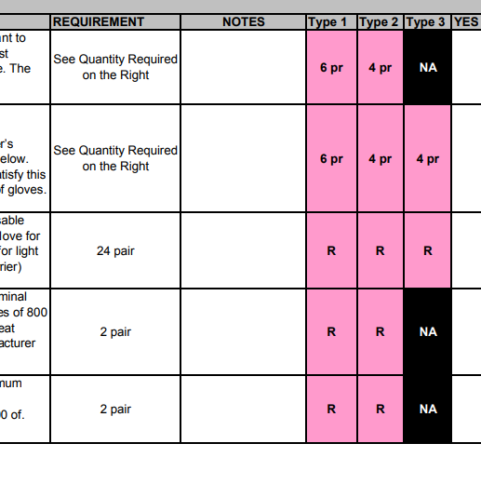
Step 1:
Look under Type 1 and identify the required number needed for each item. Additionally, more information may be found under requirement.
R – can be any amount 1+

Slide 5
Step 2
From there, you will mark, yes or no.
If yes, please note the instrument name (if applicable), the sizing (if applicable), the software (if applicable), or the true quantity inventoried.
If there is a requirement of 5, and we carry 10, please note we have 10.
If no, please write in the notes section the deficiency

Slide 6
Where do I find things: Only inventory from these vehicles!!!
ARU
HM 300 Trailer
HM 300 Truck- EXTENDO BED
ABS Trailer (absorbent)

Slide 7
Questions?
If you are unsure if something meets the requirement, please highlight the line item and I will review it.

Slide 8
Thank you for all your help!!!

