Slide 1
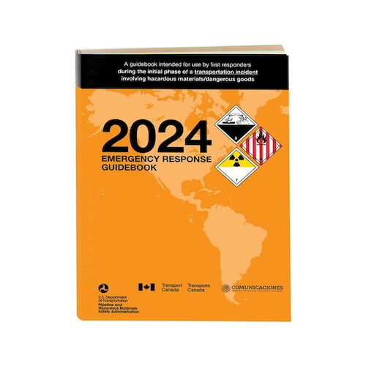
Emergency Response Guidebooks (ERG)
New additions due out March 2024
*Changes/Additions for 2024
Adding a QR code to reporting incidents
Adding information for electric vehicles
Expanding several guides, including 115 and 140
Updating the Marking, Labeling, and Placard ID charts located in the front of the ERG
Giving first aid guidance and chem warfare/biological agents their own sections
Adding/Removing several UN/ID numbers from the ERG to harmonize with the HMR (Hazardous Materials Regulations)

Slide 2
What are the ERG section colors and what do they mean?
The ERG is divided into five colored sections, which help you easily navigate through the pages and identify safety procedures when you are looking for information. The colored sections include:
All white pages, found in the front and back of the ERG, provide information for:
Instructions on how to use the ERG
General safety precautions
Notification and request for technical information
Hazard classification
Identification charts for markings, labels, placards, cargo tanks, and rail cars
Fire and spill control measures
Yellow bordered pages are arranged in order by UN or ID number and provide the guide numbers for the material.
Blue bordered pages are arranged in order by proper shipping name and provide the guide numbers for the material.

Slide 3
What are the ERG section colors and what do they mean?
Orange bordered pages include the actual response guides. Each of the guides provides safety recommendations and directions on how to proceed during the initial response phase of the incident. The guides provide information for:
Fire or explosion risks
Health
Protective clothing needed
Evacuation
Fire mitigation
Spill or leaks
First aid measures
Green bordered pages provide initial evacuation or shelter in place distances (protective action distances) for spills of materials that are Toxic-by-Inhalation (TIH).

Slide 4
Personal Protective Equipment (PPE)
February 2024

Slide 5
U.S EPA Levels of Protection
The main difference in levels of protection is the type of respiratory protection
EPA Levels:
Level A
Level B
Level C
Level D

Slide 6
Types of Respirators
Air Purifying Respirator (APR)
Air Cleaned Through Cartridge and/or Filter
Supplied Air
Pressure Demand SCBA
30 to 60 Minutes Breathing Air
Used in Oxygen Deficient Atmosphere
Can be used in Unknown Contaminant/Concentration Atmospheres
Can be used in IDLH Atmospheres

Slide 7
Respirators
GCHMU uses Scott Air Packs and Face Pieces AV2000/3000 (We will be getting MSA packs sometime in 2024)
Each Technician and Research Personnel are required to maintain and pass an annual fit test

Slide 8
Level A: (Vapor or Gas Protection)
LEVEL A
The highest available level of respiratory protection.
Fully encapsulated chemical suit with breathing apparatus.
Chemical hazard will typically have a high vapor pressure and toxicity through skin absorption or carcinogenic.
Work conditions that have a high potential (probability) for exposure to very high concentrations of chemical splash, immersion, or exposure to chemical vapors.
Situations that may involve unknown chemicals or chemical combinations.

Slide 9
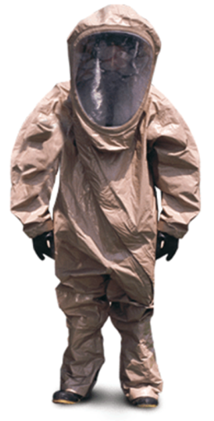
Level A Equipment
Fully encapsulating chemical resistant suit
Inhalation Hazard
Skin Hazard
SCBA
Gloves, chemical resistant
Outer
Inner
Boots
chemical resistant
Hard hat (under suit)
Highest Level of Protection

Slide 10
Level B (Liquid Splash Protection)
The same level of respiratory protection is required as in Level A. However, a lesser degree of skin protection is needed than for Level A.
SCBA
Level B protection allows for certain areas of exposed skin on the wearer.
Level B protective clothing would include either a one piece or two-piece ensemble with the SCBA worn outside the garment. Separate gloves and boots would be "taped" or "sealed" at the interfaces to minimize chemical penetration. The trend now is to use encapsulating garments that are not "vapor tight" as Level B garments.
Chemicals that are known and NOT to be vapors or gases that are toxic by skin absorption or are carcinogenic.
Exposure situations will typically be at lower chemical concentrations (below established exposure limits).

Slide 11
Level B Equipment
Gloves, chemical resistant
Outer
Inner
Chemical resistant clothing
Coverall, splash suits, one or two piece
Boots (outer) chemical resistant
Booties
SCBA
Hard hat
Face shield

Slide 12
Level C (Particle or Liquid Splash Protection)
The same level of skin protection as Level B, but a lower level of respiratory protection is needed (i.e. air purifying respirators).
APR
One or two piece splash suits are worn with a cartridge respirator.
Protective Clothing May or May Not Be Required
Chemicals are not hazardous via skin absorption and are typically well below established exposure limits

Slide 13
Level C Equipment
Air purifying respirator
Full-face or half-mask, (NIOSH approved)
Chemical resistant clothing
splash suit, one or two piece.
Gloves, chemical resistant.
Outer
Inner
Boots, outer, chemical resistant

Slide 14
Level D (No Hazard Protection)
No respiratory protection and very little skin protection is needed.
Coveralls and general safety gear (ie. shoes, gloves, eye, head wear) are worn.
The work environment has no possibility for contact with hazardous chemicals. (The workers do not expect to come in contact with chemicals)

Slide 15
Level D Equipment
Coveralls
Boots/shoes
leather or chemical resistant
Misc. (i.e. head, eyewear, hearing protection, etc.)

Slide 16
PPE Limitations
Affects Mobility
Hazard Around Machinery
Heat Stress
Work-Rest Cycle
Drink Fluids (8 oz. of Water) Every 30 Minutes
Shaded Work/Rest Area
Biological Monitoring (Heart Rate)
Administrative Controls

Slide 17
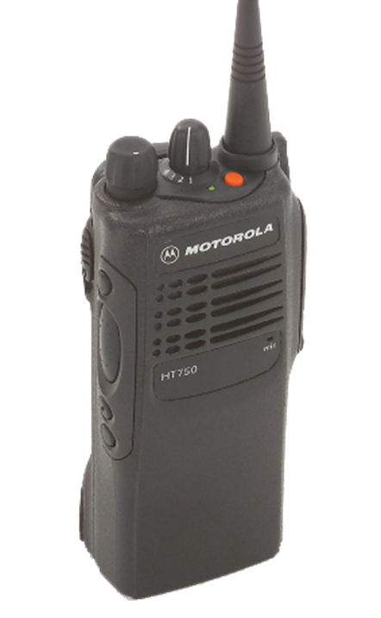
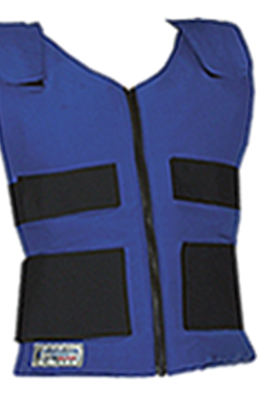
Donning
When ambient temperature is 70 degrees and above, a cool vest shall be donned.
Place all ice packs in vest
Ice packs located in fridge in each trailer
Select Radio
Turn to appropriate channel for entry
Don earpiece
Don throat mic
Test radio

Slide 18
Donning Suits and Boots
Select boot appropriate for product
Tingley
Select appropriate suit for product
Be sure to check suits limits for specific chemicals
Have a helper assist with donning of respiratory protection
SCBA
Gloves – ask research for appropriate glove selection
Inner & Outer
Tape seams
Ask research personnel for recommendation

Slide 19
Paperwork/Forms
What do I need to fill out?

Slide 20
Donning Checklist
This checklist should be filled out by a support or ops personnel each time a Technician is to make entry.
The checklist can be found in the trailers on a clip board.

Slide 21
Medical Evaluation Form
This form must be filled out completely prior to and after entry.

Slide 22
Scenarios
Put your thinking caps on

Slide 23
Scenarios
Please review the scenarios and consider the following:
Based on the incident provided, what are your concerns?
(i.e. waterways, rail, residential, school etc)
What Level PPE should be worn?
A, B, C or D
Is there an identifiable chemical? Are they Identifiable by placard?
Would you use any metering equipment or papers?
If so, what instruments?

Slide 24
Scenario 1 4,000 gallons of jet fuel overturned on a highway

Slide 25
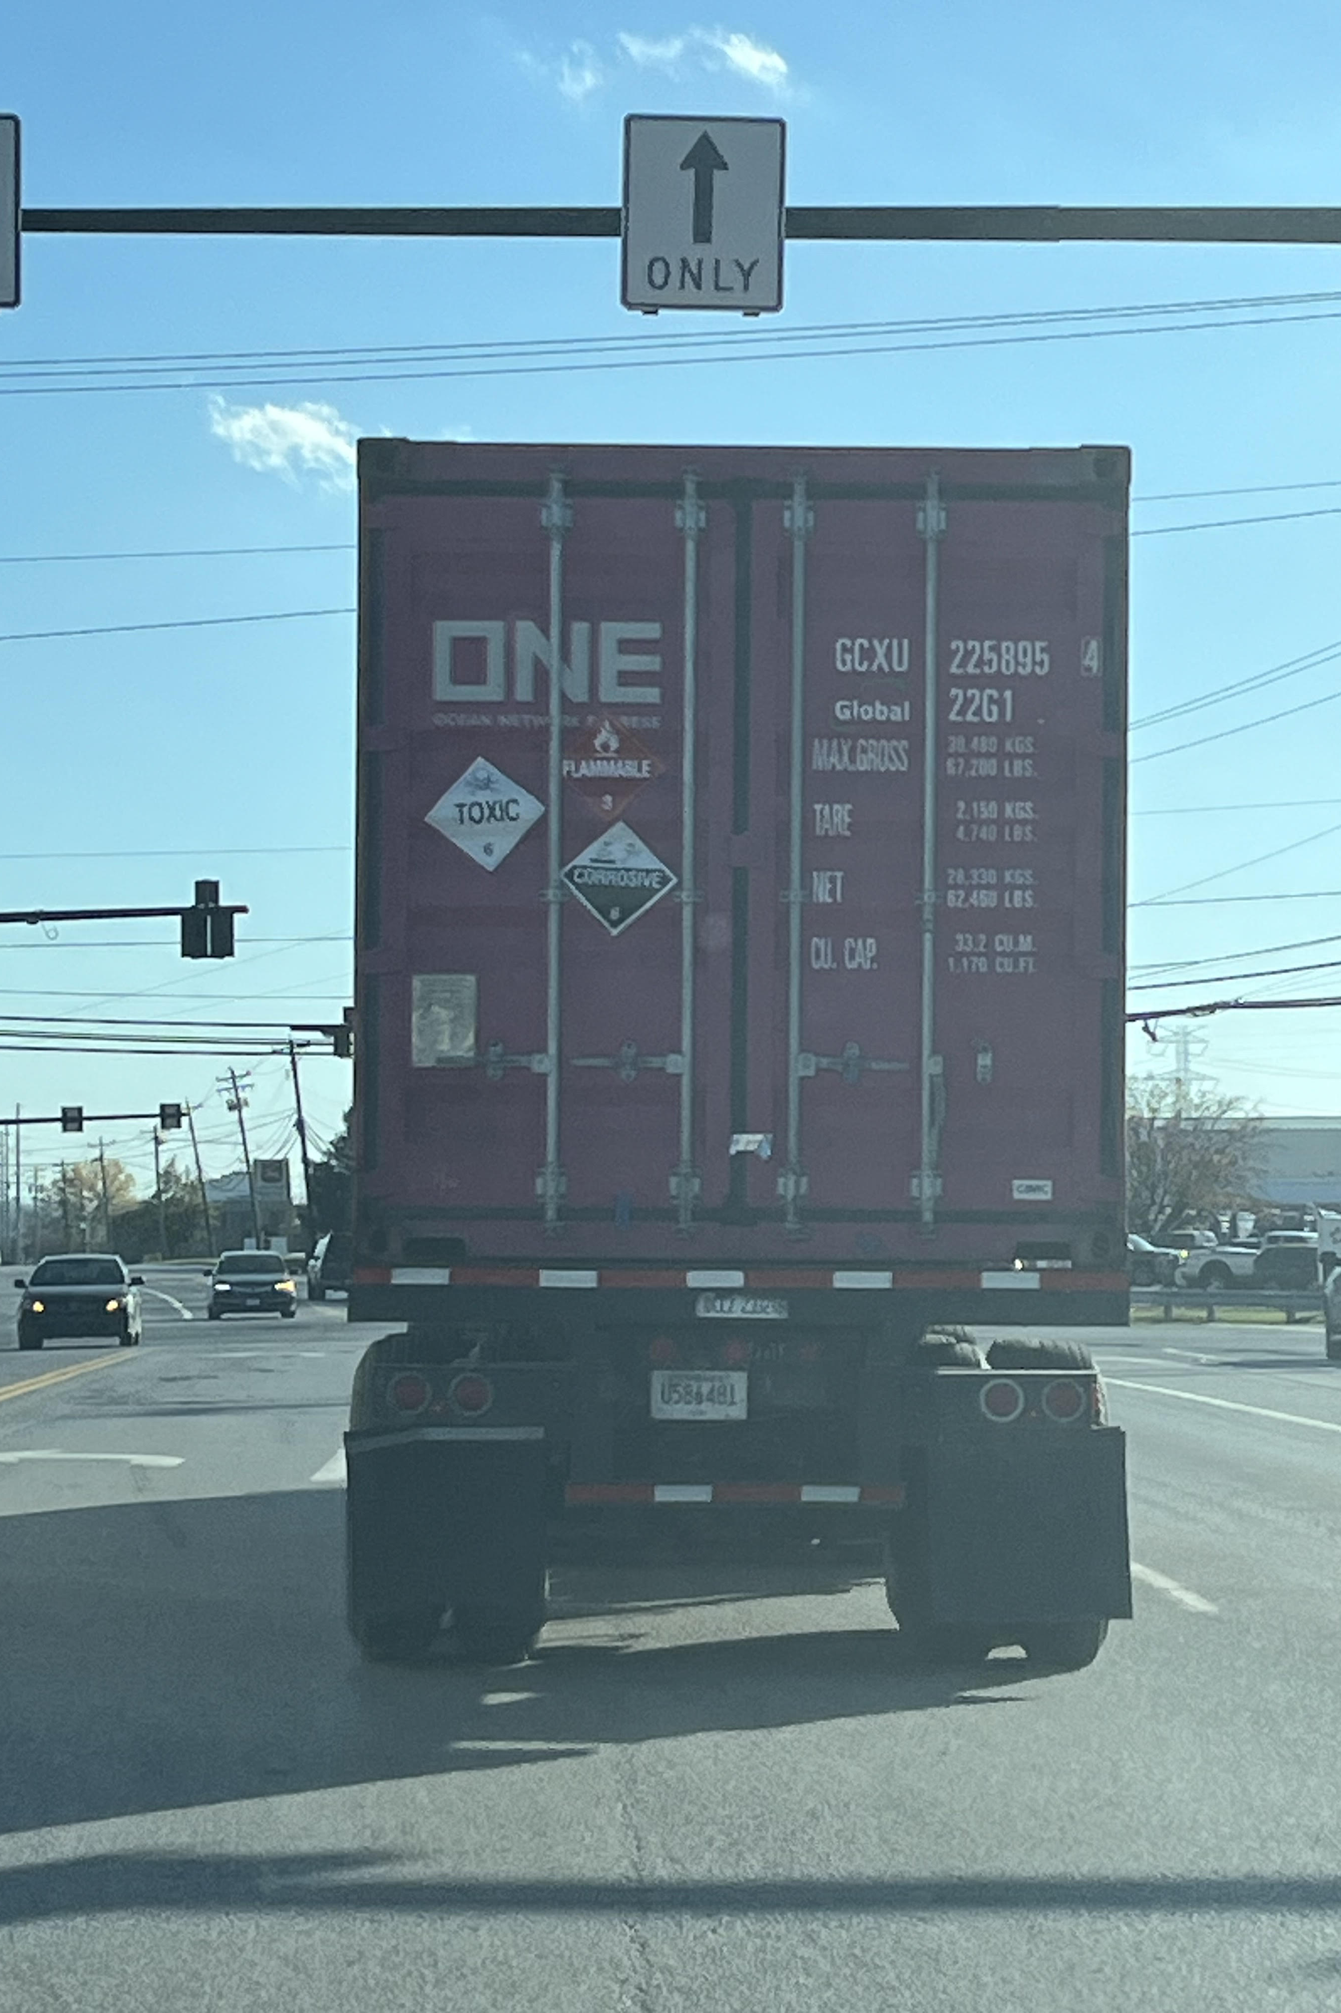
Scenario 4
Rollover accident at the intersection of Mosteller and E Kemper

Slide 26
Scenario 2

Slide 27
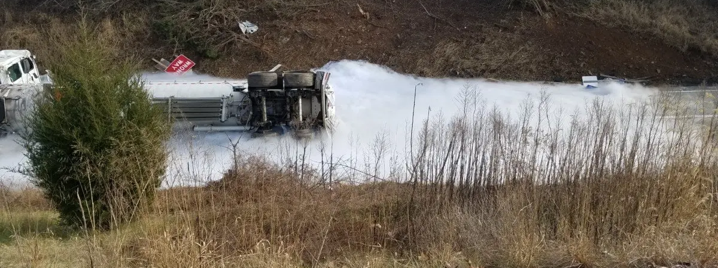
Scenario 3
Traffic accident causing a truck to run off the road causing the release of liquid oxygen. Upon arriving, no placard was visible to first responders. The driver was unconscious in the cab.

