Slide 1
January 2024
Review the Indian Springs Emergency Response Kit
What is it?
What is inside?
How to use the equipment inside
Review what a reportable quantity is
When do I have to report a spill?
Who do I need to call?
Educational Videos

Slide 2
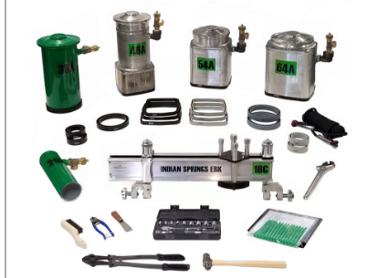
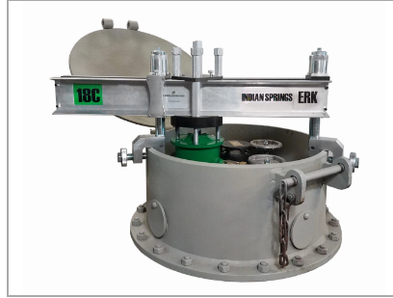
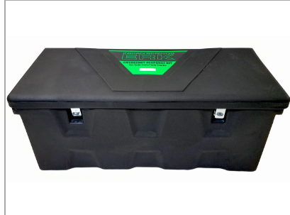
Indian Springs Emergency Response Kit

Slide 3
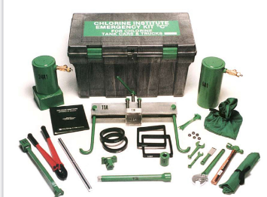
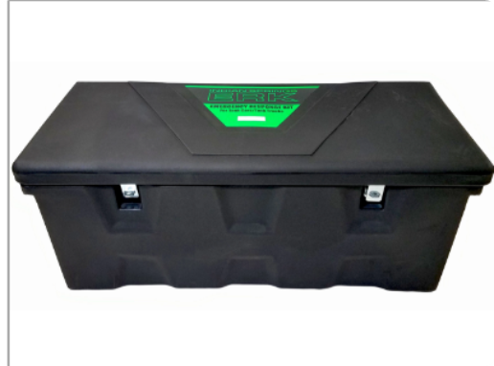
Emergency Response Kit (ERK)
The ERK is designed for use with standard tank cars, cargo tanks and portable tanks. This kit should not be used on
This kit will work on standard chlorine housings, sulfur dioxide and ammonia
Color coded GREEN as this works in conjunction with the Chlorine “C” Kit

Slide 4
ERK Features
One piece adjustable, aluminum yoke assembly
Yoke assembly opens to a span of 38” Maximum housing ring thickness = 1-1/2"
Yoke assembly does not require port hole openings for attachment
Yoke assembly can be placed anywhere along housing ring
No “bridge” yoke needed to contain sampling valve and thermowell
Three aluminum, Teflon-lined capping hoods and outlet valves, 2 Steel Hoods (5 total)
Custom molded Viton (black) and EPDM Gaskets (Grey)
Yoke assembly works with existing tank car kits in field

Slide 5
What's Inside?
https://www.youtube.com/watch?v=CdHsPNj9Uwc
Viton Gaskets – black (chlorine)
EPDM Gaskets – Grey (Sulfur Dioxide, Ammonia)
30A, 46A – Standard angle valves on chlorine tank car and Chlorine pressure relief valves
18C – fixed end and adjustable end

Slide 6
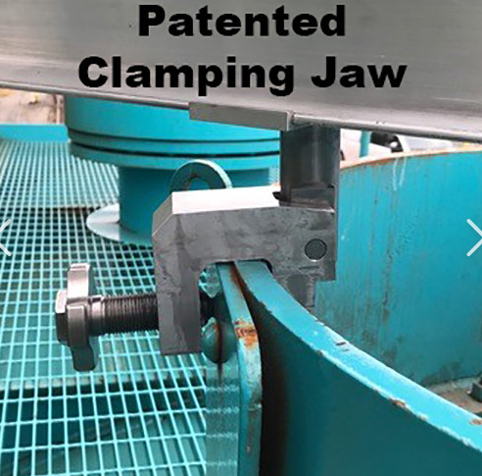
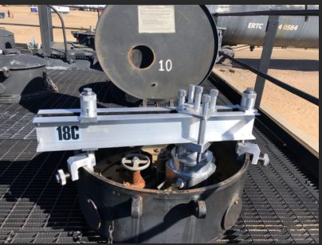

Slide 7
Reportable Quantity
The amount of material that needs to be reported to the NRC for a hazardous substance is known as the reportable quantity.
The reportable quantity depends on the type of substance released and where it is released.
Ohio EPA's spill hotline should only be used to report emergencies involving the release of any material that impacts public health or the environment, including chemicals, petroleum, manure, fires/explosions, or to make an emergency notification to Ohio EPA as required by law or by permit

Slide 8
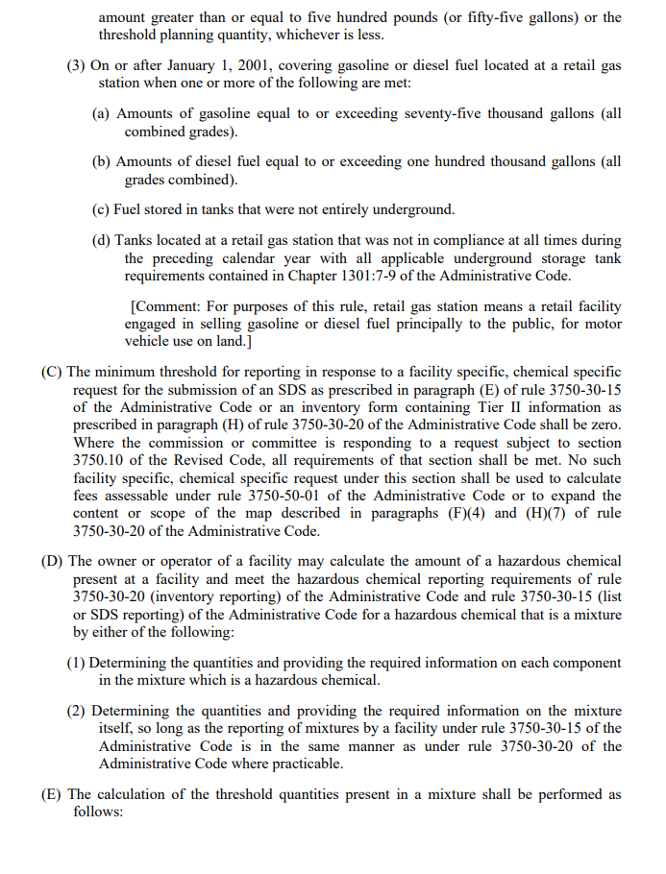
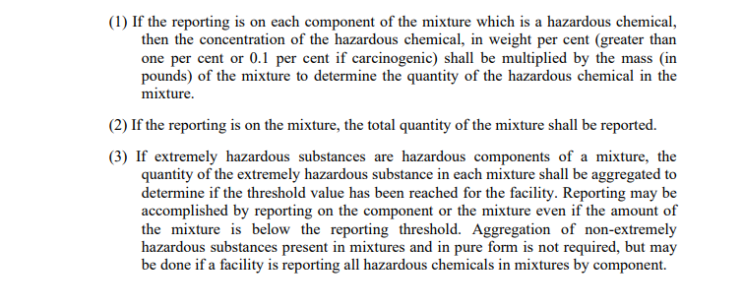
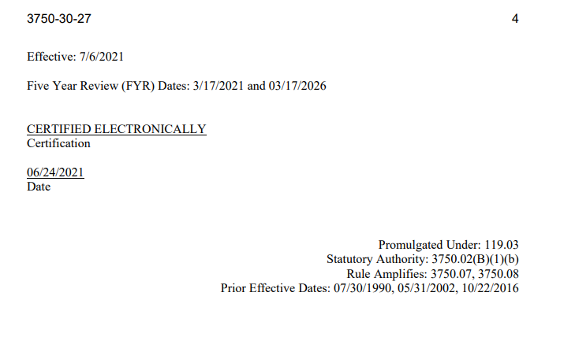
Administrative Code 3750-30-27 Threshold Quantities for Hazardous Chemical Reporting

Slide 9
Release Reporting of a Hazardous Substance

Slide 10
Contact Numbers:
CHEMTREC: 1-800-424-9300
NRC (National Response Center): 1-800-424-8802
OEPA: 1-800-282-9378

Slide 11
Educational Videos
https://www.youtube.com/@indianspringsmanufacturing4241
Jack Rabbit II Release Tests Trials 7-9: https://www.youtube.com/watch?v=kPyc68ZR13E&t=8s
https://www.youtube.com/watch?v=cAHrWffWe6E&t=4s
https://www.youtube.com/watch?v=VnZWTSG9Rc8
Anhydrous Tank Leak – Fairbault, MN – Tank hose broke and sprayed AA all over the field. https://www.youtube.com/watch?v=fYRVQfdFHZ0
Social Media Trends/Tik Tok trends: https://www.youtube.com/watch?v=SpveK0exFeU
https://www.youtube.com/shorts/GRFyynXPIao
https://www.youtube.com/shorts/7jF5-ITr5ZI

