Slide 1
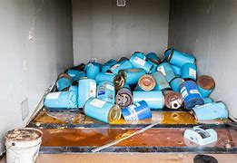
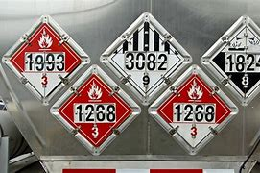
Greater Cinti Hazmat

Slide 2
Dispatch When asking dispatch, please ask for Greater Cincinnati Hazmat Unit
The unit is dispatched through Hamilton County Communications Center 513-825-2260
The Unit must be requested by the Police/Fire Department Incident Commander

Slide 3
Operations
GCHMU has 3 part time Duty Officers
Chief Don Bennett
Chief B.J Jetter
Dennis Waldbillig
1 Office Administrator
Brooke Matzen
Membership is comprised of Technicians, Specialists, Research and Operations personnel

Slide 4
Response Services
Administrative Consultation
Phone call with Duty Officer to confirm you are doing the right thing
Administrative Response
Response by a Duty Officer and or Chemist to assist your IC
Full Team Response
Duty Officer, Research Team and up to 12 HM Technicians
We are not going to take over any incident. We are a tool in your toolbox.
Our job is to support you

Slide 5
What we need from the requesting agency
A staging location for our personnel to meet and set up
Many of our personnel arrive in pov’s
A fire ground we can talk to units
Assistance with setting up Decon line upon arrival on scene and water
We will provide a Decon Leader and equipment
Any information pertaining to release/spill- placard, color, plume, smells, where its located, etc
We may ask for a picture to be sent via text or email if possible

Slide 6
Setting up a Decon Corridor

Slide 8
Examples of Equipment Items for Decon
Plastic Sheeting
Lowes/Home Depot
Decon Solution
Dawn
Rinse Water
Long and short handled brushes
Toilet or Car Wash Brush
Stools
Tape
Gloves - Nitrile
Water Spray Units
Cones
Tarps/Drop Cloths
Buckets
5 gallon – Home Depot or Lowes

Slide 9
Awareness of Incident
The first fifteen minutes on the scene of a hazardous materials incident will set the stage for the remaining response. If the initial response is safe and appropriate, and the first responder fulfills their duty to recognize, identify, isolate, protect, notify and establish command then the subsequent responders can build upon this foundation and safely mitigate the hazard.

Slide 10
Notifications
Notifications depend on the size, scope and complexity of an incident. Proper notifications may need to be made to the following agencies:
Fire Departments / Emergency Medical Services
Police Departments / Sheriff’s Offices / Highway Patrol
Hazardous Material Response Teams
FBI (WMD Related Incidents)
Environmental Protection Agency
Public Health Departments
Public Utilities Commission
Environmental Clean-up Companies
Local Emergency Planning Commission (LEPC)

Slide 11
What information do you need to report?
The chemical name, placard and/or U.N. number with a description of the incident, if available.
Weather conditions and wind direction
Status of the hazardous material container – (stable, leaking, burning, etc.,)
The location impacted (residential, commercial, industrial, etc.,)
Victim’s injuries , if known

Slide 12
PUCO – Public Utilities Commission
Anyone carrying hazardous materials is subject to the federal HMR and must comply with the applicable placarding requirements. General placarding requirements are contained in 49 CFR Subpart F Part 172 of the HMR.
Each bulk packaging, freight container, unit load device, transport vehicle or rail car containing any quantity of hazardous materials must be placarded on each side and each end with placards specified for the type of material being transported.
Basics for hazardous materials carriers | Public Utilities Commission of Ohio
The PUCO employs hazardous materials specialists throughout the state of Ohio who are available to assist with investigations of hazardous materials transportation related issues and incidents.
In cases of emergency, the PUCO maintains a 24-hour Hazardous Materials Incident Reporting Line at (800) 642-3443 to which incidents involving hazardous materials can be reported.
The PUCO provides technical assistance to emergency responders; conducts investigations at the scene of a hazardous materials accident; assists with identifying hazardous materials; ensures proper compliance with regulations for transport; and conducts radiological surveys and contamination control surveys of radiological shipments.
Upon calling the Hazardous Materials Incident Reporting Line, PUCO personnel will inform you of the availability and estimated time of arrival of a PUCO hazardous materials specialist.

Slide 13
Placards

Slide 14
Labels or Placards MUST be displayed on at least 2 sides or two ends when:
A volume of 64 cubic feet or more
Non bulk packages that contain radioactive material
DOT 106 or 110 multi unit tank cars
Portable tanks less than 1000 gallons capacity
Freight containers or unit load devices with a volume of 64 cubic feet or more
Intermediate bulk containers that have a volume of 64 cubic feet or more.

Slide 15
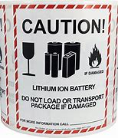
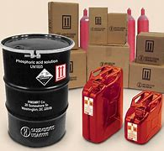
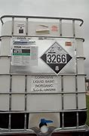
Bulk Hazmat Packaging

Slide 16
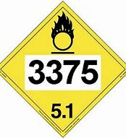
What is a UN Number? A UN Number is a 4-digit number that identifies Hazardous Materials such as explosives, flammable liquids, oxidizers and some acutely toxic substances

Slide 17
UN 3266
Corrosive Drum involved in a burning house

Slide 18
No visible placard on exterior of box truck Totes were improperly stored
Painters Ink
UN 1210

Slide 19
Transportation Accident involving Hazardous Materials
Where’s the driver?
If injured, check the door for manifest
Find the manifest
The manifest is required to be in the driver's side door
Check for placard
Depending on the truck/trailer you may only have a generic placard (flammable, explosive, corrosive) and no U.N number
Check for any signs of leak or fuming, smells from the truck/trailer
Any pooling or hissing

Slide 20
Hydrocarbons
The most common kind of hazmat incident involves hydrocarbons, better known as gasoline, diesel fuel, oil and natural gas in liquid and gas forms.
Accounting for over 75 percent of all hazardous materials transported throughout the United States, an accident involving these substances can result in explosions, lethal vapors, extensive property damage and environmental pollution.

Slide 21
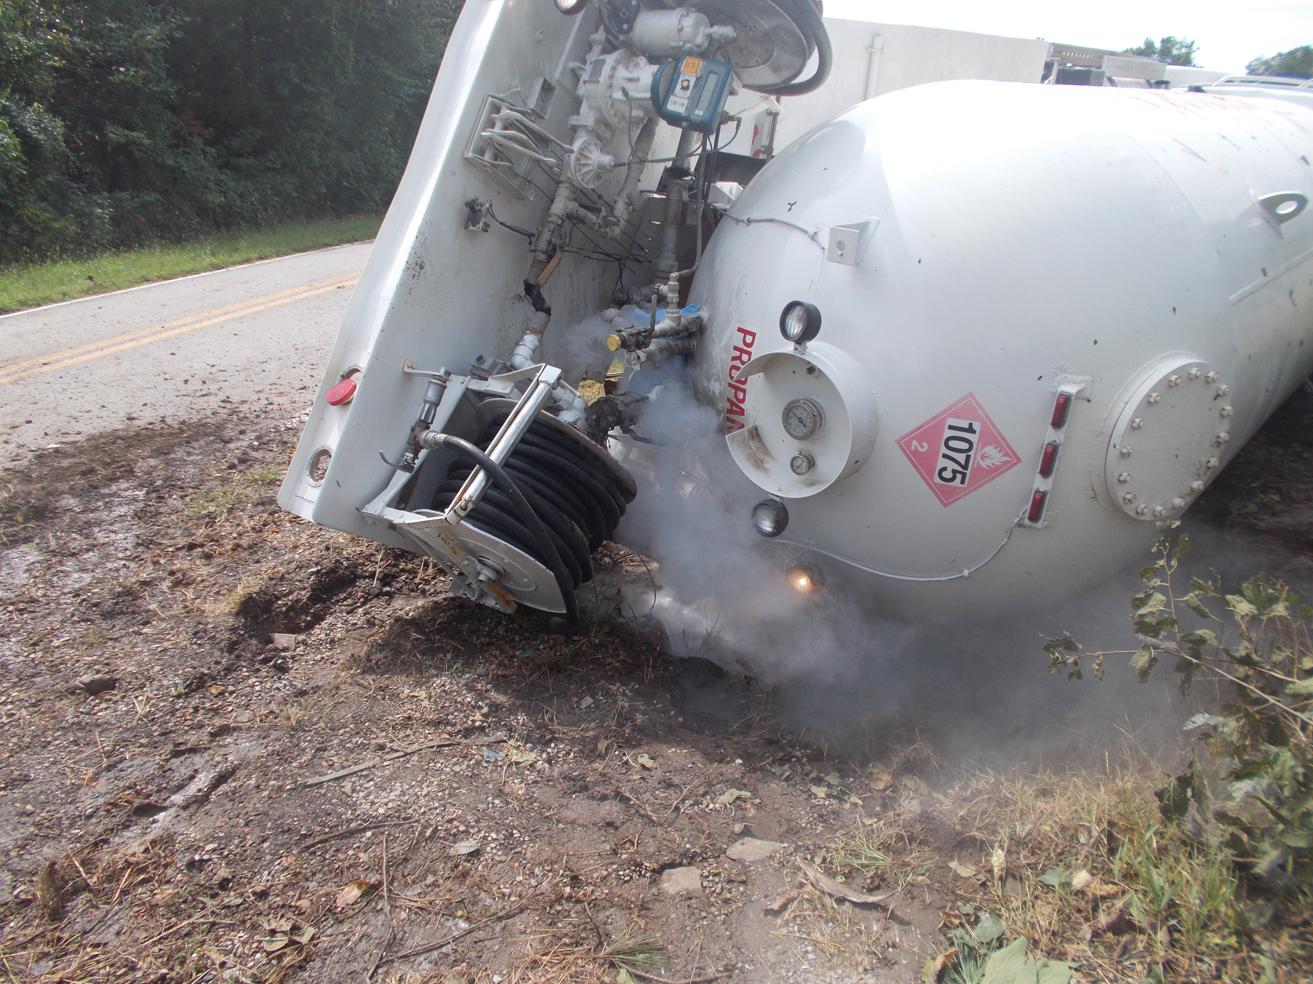
DOT 407 and 412
Gasoline – UN 1203
Diesel- UN 1993 (Fuel Oil), UN 1202 (Gas Oil)
Propane or Liquefied petroleum gas- UN 1075

Slide 22
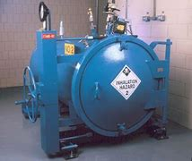
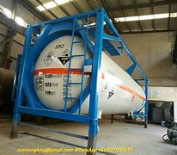
DOT 106
Chlorine, Refrigerant gas and liquid transportation
Commonly referred to as Ton Tanks or Ton Containers, and internationally recognized as a horizontal drum or pressure vessel
Class 2 gases including PIH gases of Div 2.1 and Div. 2.3 (Zones B, C & D)
Class 3 flammable liquids
Class 4 pyrophoric (dangerous when wet) materials
Class 6 toxic or infectious liquids
Commodities such as Chlorine, Ammonia, Refrigerants, Dinitrogen Tetroxide, etc.
106A500X is the only approved container for transport of Chlorine

Slide 23
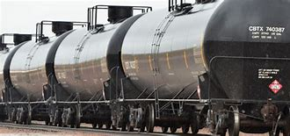
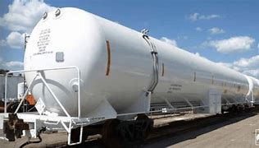
DOT 111
Chlorine, Refrigerant Gases, Other aggressive gases and liquids
Multi unit tank car trucks, known as horizontal drums or pressure vessels
Class 2 gases including PIH gases of Div. 2.3 (zones B, C & D)
Most class 3 flammable liquids
Class 4 pyrophoric (dangerous when wet) materials
Class 6 toxic or infectious liquids
Class 8 corrosive liquids (stainless tanks only)
Commodities such as refrigerant, fire-extinguishing gases, etc.

Slide 24
Gasoline Tanker Response – things to consider
The specific gravity of these petroleum products is below 1; therefore, these products will float on water.
These products have a vapor density well above 1; therefore, the vapors will sink.
These products have a low ignition temperature (about 400°F), depending on the grade and blend.
The operation temperature of a catalytic converter on a typical vehicle is more than 400°F, providing an ignition source for petroleum vapors.

Slide 25
Gasoline Tanker Response Continued
Petroleum products such as ethanol and E-85 (85 percent ethanol) gasoline for “flex fuel” vehicles are polar solvents and mix well with water; therefore, normal firefighting foam will not work well when used as a blanket on unignited spilled fuel or as a firefighting agent. Polar solvents necessitate special foam agents and mix ratios.
Because a gasoline tanker is a non-pressure tank, it is constructed of aluminum, and has many openings, there is a limited chance of a boiling-liquid, expanding-vapor explosion (BLEVE).
How do you know if a fire involving a tanker or at a gas station is a flammable-vapor or a flammable-liquid fire? By the smoke! Vapor fires lack smoke; liquid fires will emit massive amounts of black smoke.

Slide 26
Gasoline Tanker Response Continued
Tankers are usually multicompartment (four or five compartments are most common) and often carry a “mixed load,” such as three compartments of gasoline and one compartment of diesel.
U.S. Department of Transportation (DOT) placarding requires that a tanker carrying various regulated products (mixed load) be placarded with whatever product was, or is, in a compartment that has the lowest flash point. For example, a tanker with 6,000 gallons of diesel fuel onboard and an empty compartment that contained gasoline will be marked with the placard for gasoline because the flash point of gasoline is less than that of diesel.
Storm water drains/systems typically lead to either a retention area/pond, or a creek/stream/river. Many areas now have stormwater retention areas under parking lots. Some areas have stormwater pipes that lead to a water treatment facility. Know where the spilled products will be traveling to in your area. They may be on fire or traveling toward an ignition source—location, location!

Slide 27
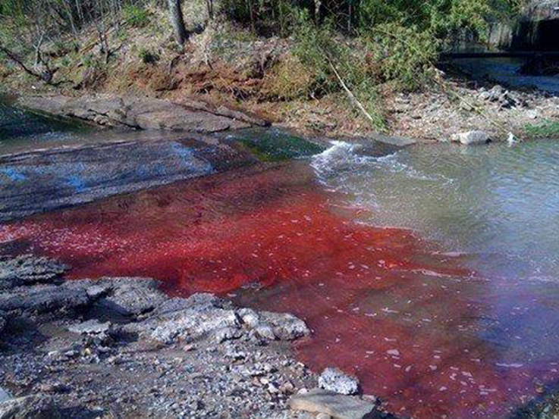
First unit on scene,
What information can you relay about the accident ?
What notifications are you going to make?

Slide 28
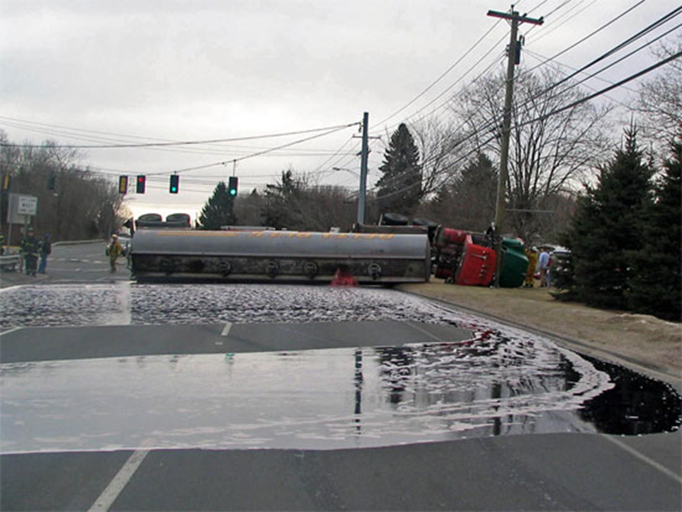
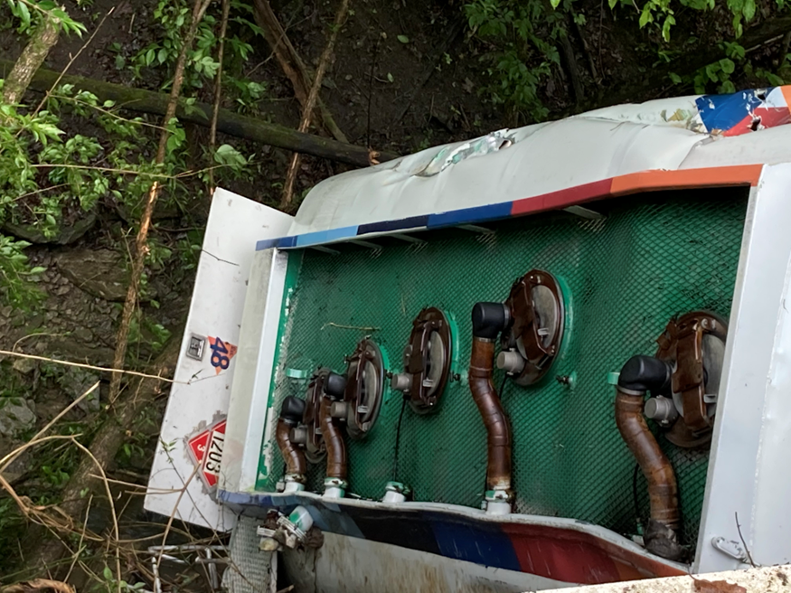

Slide 33
Car t-boned a semi striking the saddle tank

Slide 34
AskRail
The AskRail® app is a safety tool for first responders.
The app provides more than 25,000 first responders — from all 50 states and eight Canadian provinces — with immediate access to accurate, timely data about what type of hazardous materials a railcar is carrying so they can make an informed decision about how to respond to a rail emergency.
AskRail Mobile App

Slide 35
Hotlines
BNSF 1-800-832-5452 (option 1)
CN 1-800-465-9239
Canadian Pacific 1-800-716-9132
CSX 1-800-232-0144
KCS 1-800-892-6295
Norfolk Southern 1-800-453-2530
Union Pacific 1-888-877-7267

Slide 36
Rail
Railroads have teams of full-time personnel and environmental, industrial hygiene, hazmat, and medical consultants and contractors whose primary focus is hazmat safety and emergency response. These trained professionals are strategically located throughout the nearly 140,000-mile freight rail network and are available 24/7. Railroads also strategically position emergency response equipment along their routes; maintain a police force that works alongside emergency responders in the event of an emergency; and provide 24-hour emergency hotlines for first responders and the public.
According to the US Department of Transportation, the rail freight network is an 80-billion-dollar industry with around 140,000 route miles of track, accounting for approximately 28% of all freight movement within the US! Not only that, but the “US freight rail network is widely considered the largest, safest, and most cost-efficient freight system in the world.”

Slide 37
Rail
Rail transportation services are incredibly safe for chemical shipment. The Association of American Railroads (AAR) states, “99.99% of all hazmat moved by rail reaches its destination without a release caused by a train accident.” Hazmat accident rates have even decreased by 64% since 2000 due to the collaboration of private freight companies, customers, government agencies, and all other involved parties in investing money and labor into ensuring safer practices for hazmat rail transportation services, with the ultimate goal of one day being 100% accident-free.

Slide 39
Train Derailment
When it comes to responding to a hazardous train derailment, the challenges that first responders may face will include a large-scale incident, a hazardous material release, a fire or explosion, and civilian injuries and evacuations.
Proper PPE and accountability of personnel
Life Safety
Snatch and grab or wait for assitance
Locate the conductor
Ask questions!
Locate the manifest
Check to see what the train is carrying
Evacuate or Shelter In Place

Slide 40
Stationary cars can present a problem as well

Slide 42
Don't Try This at Home - 3 - Sulfuric Acid and Sugar - Bing video
https://www.youtube.com/watch?v=aBVdGGml6bU

Slide 43
Ohio EPA Spill Line 800-282-9378
Ohio EPA's spill hotline should only be used to report emergencies involving the release of any material that impacts public health or the environment, including chemicals, petroleum, manure, fires/explosions, or to make an emergency notification to Ohio EPA as required by law or by permit.
Please remember that all spills affecting waterways (creeks, storm sewers, sanitary sewers, rivers, lakes) MUST be reported to the OEPA regardless of amount
Any spills over 25 gallons must be reported to OEPA and Hamilton County LEPC

Slide 44
Ohio EPA 800-282-9378
When reporting a spill, release or environmental crime through the spill hotline, be prepared with as much of the following information as possible:
Responsible party (name of carrier, owner, operator or facility).
Date/time (discovered/occurred).
Location (address, cross street, mile marker).
Material(s) (chemical, product, or common name).
Quantity (estimated release/total).
Hazards (extremely hazardous substance, placard, materials safety data sheet [MSDS]).
Affected media/area (air, land or waterway, including threats to ditches, sewers, streams).
Actions/notifications (evacuations, containment, contractor hired).
Contacts on scene (responder cell phone number, responsible party, contractor, facility point of contact).
Other useful information (truck DOT or rail car number, chemical UN ID number, MSDS, etc.).

Slide 45
Contact Info
1881 E Crescentville Road
Office 513-779-1200
Fax 513-779-0703
www.gchmu.org
Brooke Matzen – Office Administrator
Brmatzen@gmail.com

