Slide 1
The Greater Cincinnati Hazmat Unit

Slide 2
About us
We are governed by a Board of Trustees representing the fire service, the public, local government, and tri state businesses. Members are from the fire service, public service organizations and are industrial/government technical personnel.
The Unit is a verified Type 1 Hazmat response team as defined by the State of Ohio Hazmat Technical Advisory Guidelines. This is the highest level of typing for a Hazmat team in the State of Ohio.

Slide 3
Operations
GCHMU has 3 part time Duty Officers
Chief Don Bennett
Chief BJ Jetter
Dennis Waldbillig
1 Office Administrator
Brooke Matzen
Membership is comprised of Technicians, Specialists, and Operations personnel

Slide 4
Response Services
Administrative Consultation
Administrative Response
Full Team Response

Slide 5
Administrative Consultation
The on-call duty officer will call the incident commander at the number given to the communications center upon receipt of call.
*Be sure to give a good call back number *
The duty officer will provide information such as if a clean up contractor is needed, advice on clean up, reassurance on what your doing, contact with a chemist or EPA on scene coordinator.

Slide 6
Administrative Response
A duty officer responds to the scene and provides expertise in mitigation. A chemist or other specialty personnel may be called upon.

Slide 7
Full Team Response
A response that includes a duty officer, chemists, technicians and apparatus.
Duty Officer
Truck/Trailer Combo
8-10 Technicians/Support Personnel
Analytical Response Unit
1-2 Chemists and Analytical Staff

Slide 8
Dispatch
The unit is dispatched through Hamilton County Communications Center 513-825-2280
Please request to speak with a Duty Officer from Greater Cincinnati Hazmat (if you use wording: Cincinnati Hazmat or Hamilton County Hazmat there will be a delay!)
The Unit must be requested by the Police/Fire Department Incident Commander

Slide 9
What we need from the requesting agency
A staging location for our personnel to meet and set up
Many of our personnel arrive in pov’s
A fire ground we can talk to units
Assistance with setting up Decon line upon arrival on scene and water
We will provide a Decon Leader and equipment
Any information pertaining to release/spill- placard, color, plume, smells, where its located, etc
We may ask for a picture to be sent via text or email if possible

Slide 10
Resources
2 Truck and Trailer Combinations – Loaded with equipment for all level of entry
Sharonville – Office
Deerfield Township Fire, Station 57
1 Foam Truck – Qty 16, 55-gallon drums of AR-AFFF 1%/3%
City of Fairfield, Station 32
1 Analytical Response Unit – Metering and Monitoring Equipment
Sharonville - Office
2 Absorbent Trailers – Booms (hard and soft), Pads, Pillows, Socks, Pigs, Overpacks
City of Fairfield, Station 33
Sharonville – Office (currently under renovation)
1 Command Van (Command 400)
Sharonville - Office

Slide 11
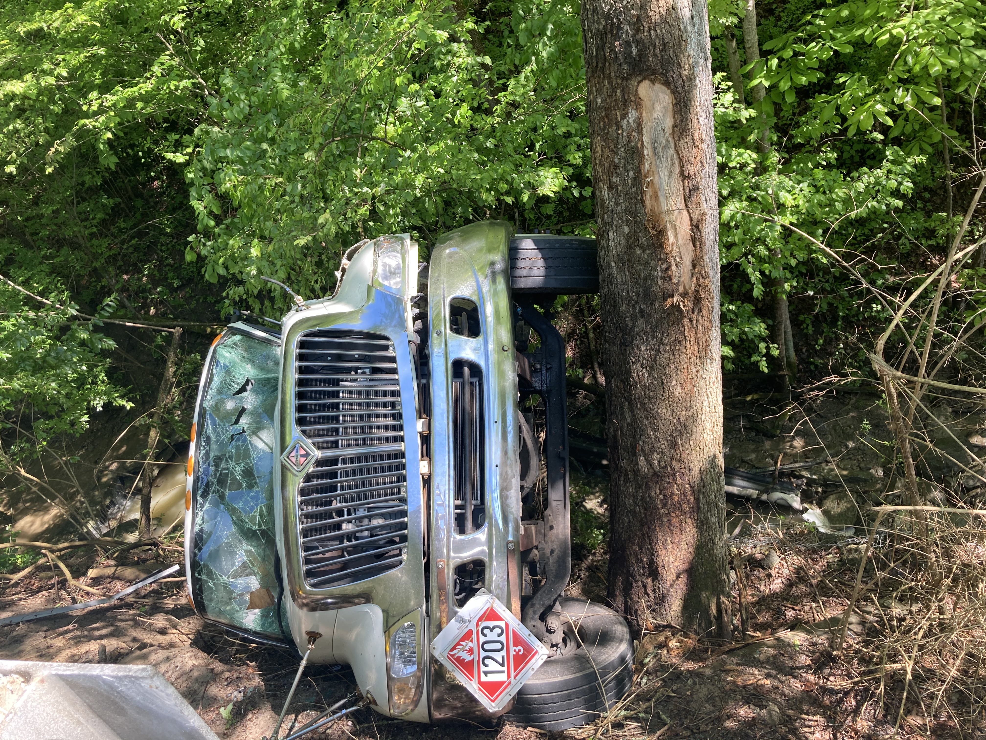
What information can you relay to the duty officer?

Slide 12
Decon
The process of removing or neutralizing contaminants that have accumulated on personnel or equipment.
The process of removing hazardous materials to prevent the spread of contaminants beyond a specific area and reduce the level of contamination to levels that are no longer harmful
Is performed when a victim, responder, animal, or equipment leaves the hot zone

Slide 13
Setting up a Decon Corridor

Slide 14
Decon Line

Slide 15
Examples of Equipment Items for Decon
Plastic Sheeting
Lowes/Home Depot
Decon Solution
Dawn
Rinse Water
Long and short handled brushes
Toilet or Car Wash Brush
Stools
Tape
Gloves - Nitrile
Water Spray Units
Cones
Tarps/Drop Cloths
Buckets
5 gallon – Home Depot or Lowes

Slide 16
Hazardous Substances (HS) and Extremely Hazardous Substances (EHS)
Who is required to submit an annual chemical inventory report?
A facility with “Hazardous Substances” (“HS” means it has an SDS document)
If they have more than 10,000 lbs. on hand
A facility with “Extremely Hazardous Substances” (“EHS” are defined by the EPA)
If they have more than 500 lbs. on hand (or less depending on the chemical)

Slide 17
Reporting Facilities in Hamilton County
650 facilities are reporting to the LEPC each year
325 have chemicals defined as EHS (Extremely Hazardous Substances)

Slide 18
What chemicals are in the area?

Slide 19
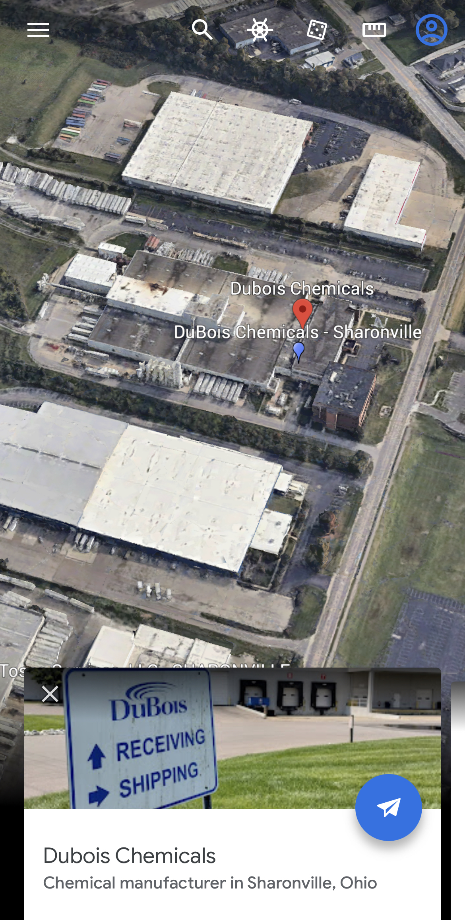
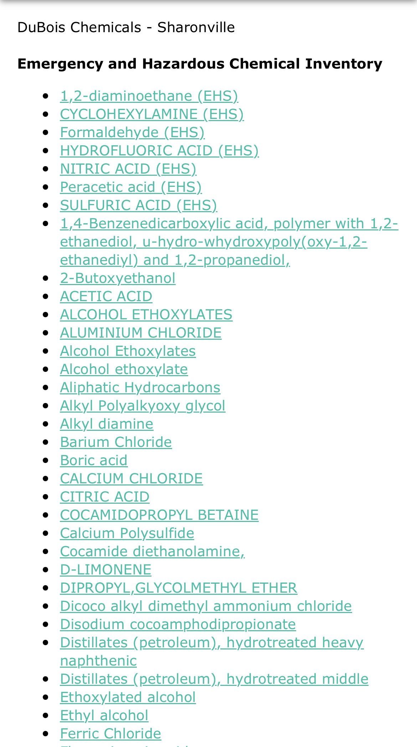
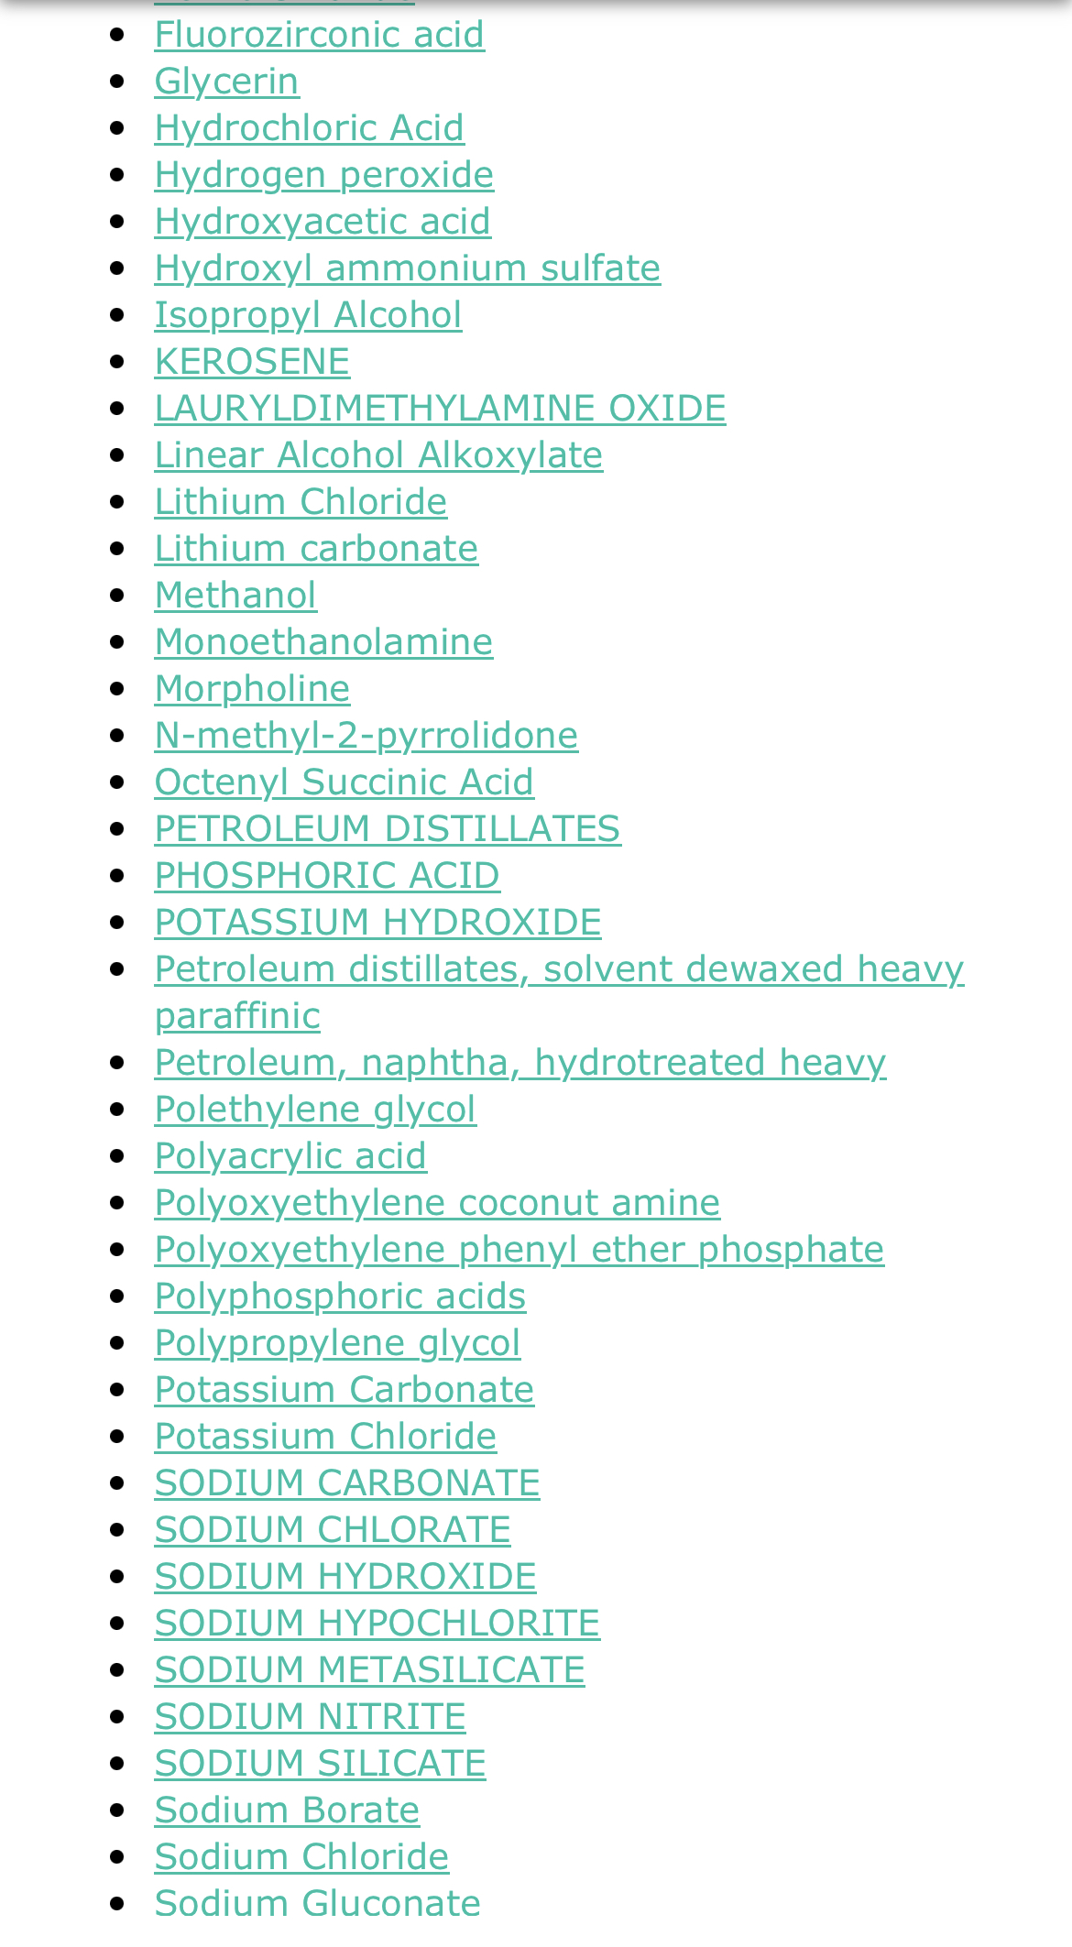
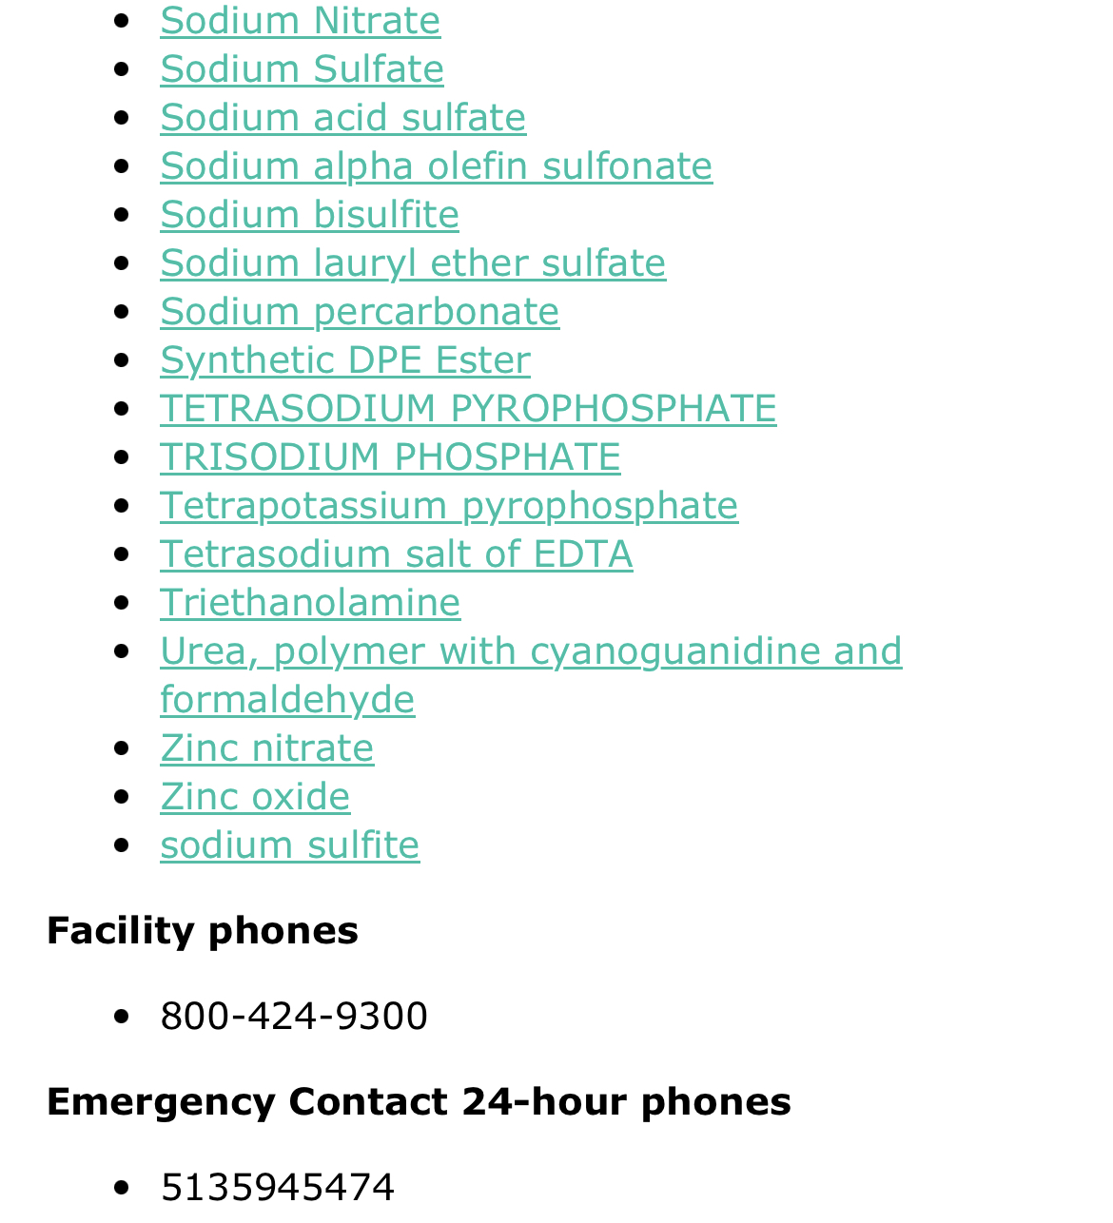
DuBois Chemicals 3630 E Kemper Rd

Slide 20
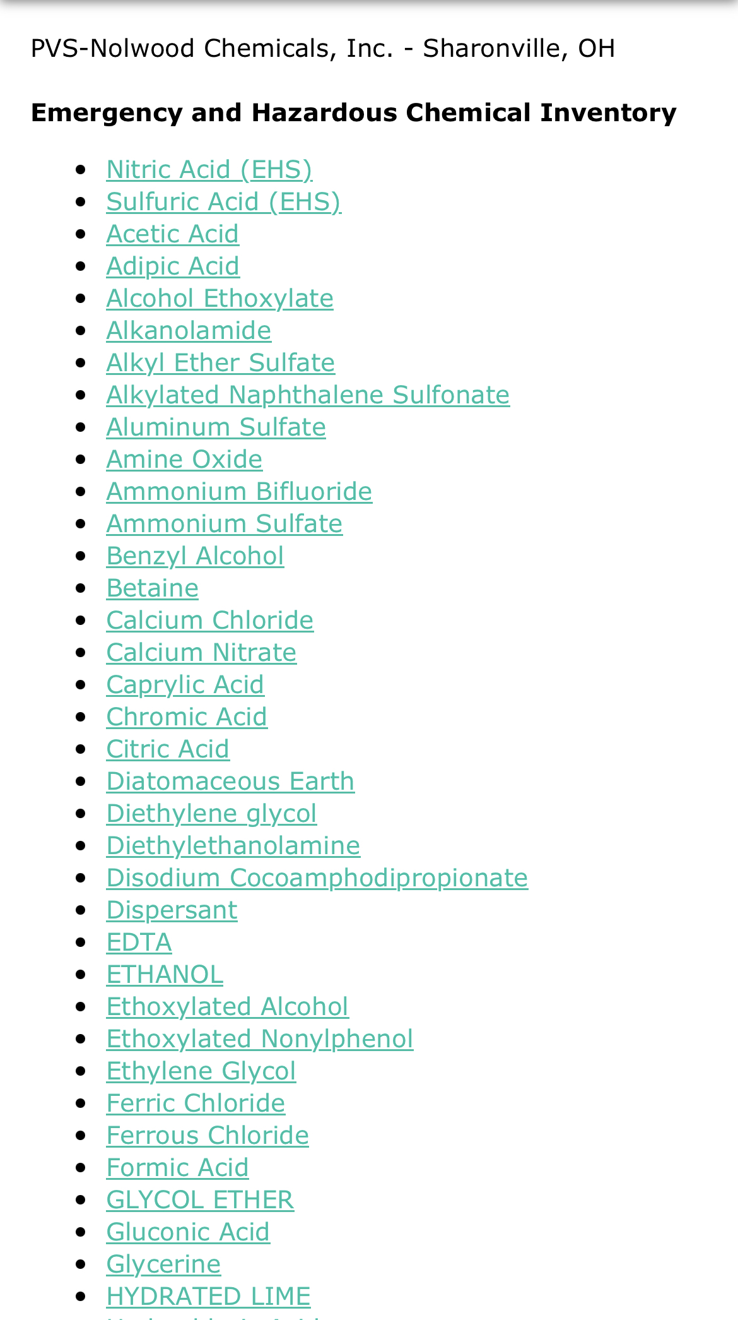
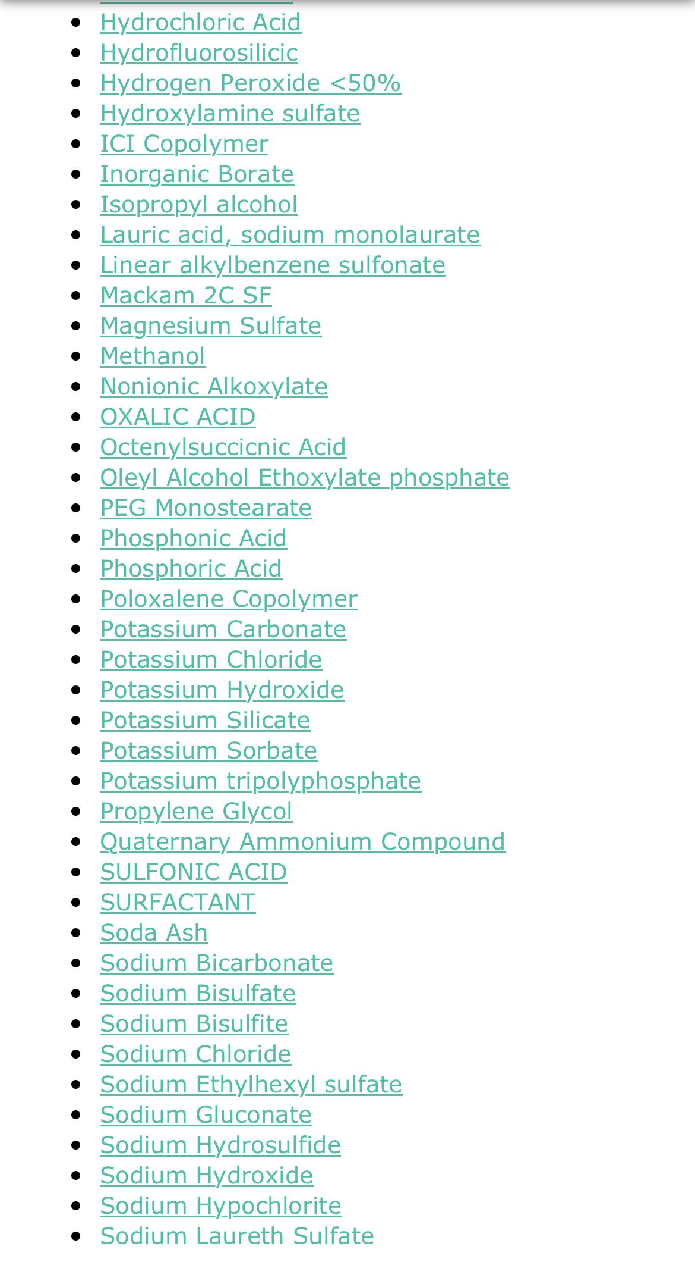
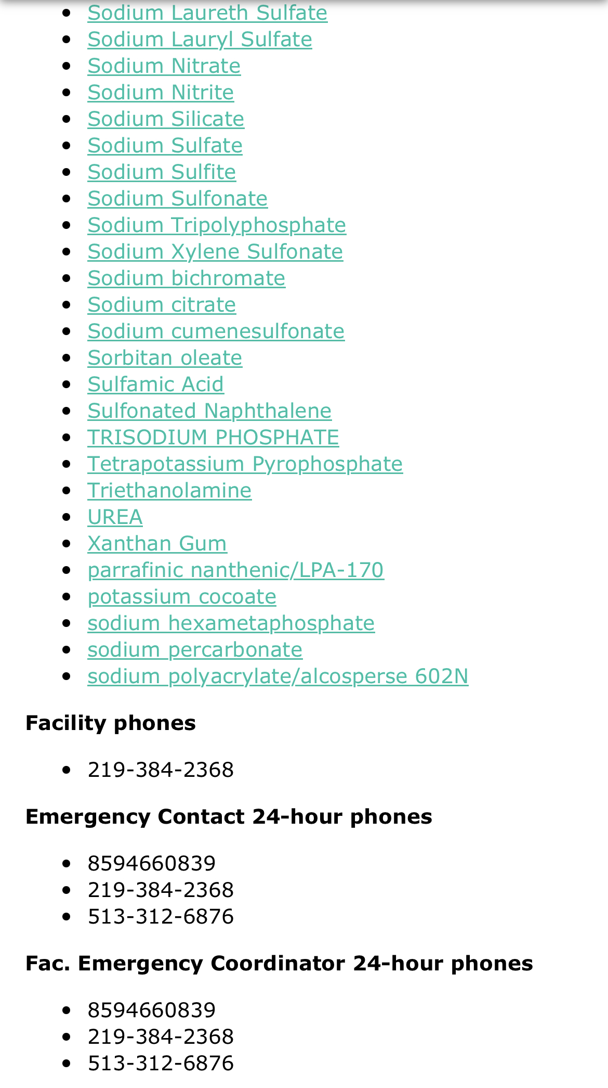
PVS-Nolwood Chemicals, Inc 2551 Crescentville Rd

Slide 21
PVS Distribution Sites: 6 (5 in USA, 1 in Canada) **Sharonville Manufacturing Plants: 3 International (Germany, Thailand, Belgium), 12 USA Terminal Distribution Sites: 16 USA Corporate Headquarters: Detroit, Michigan

Slide 23
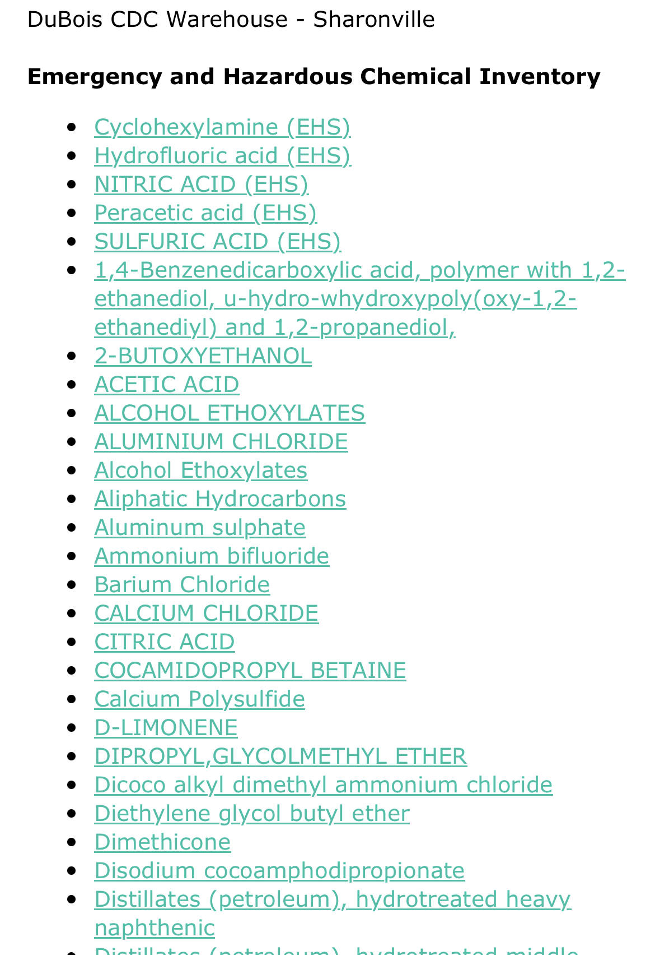
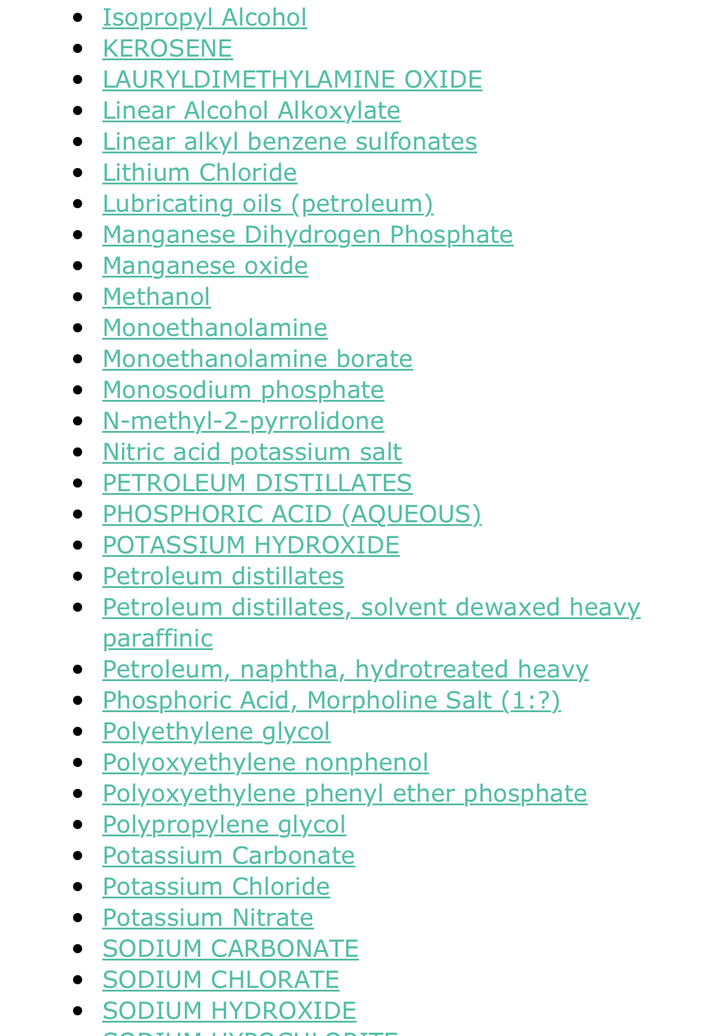
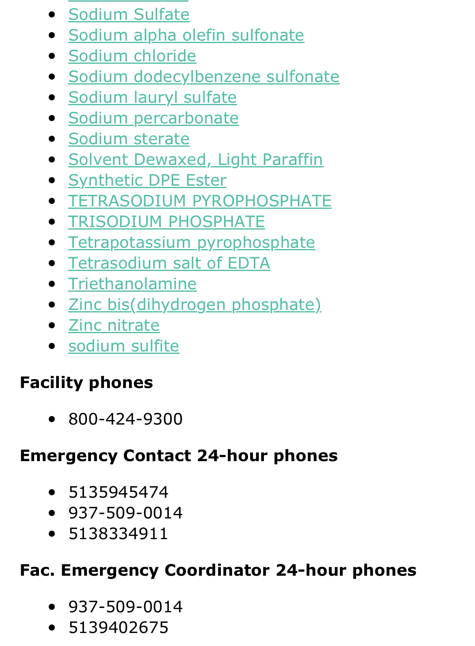
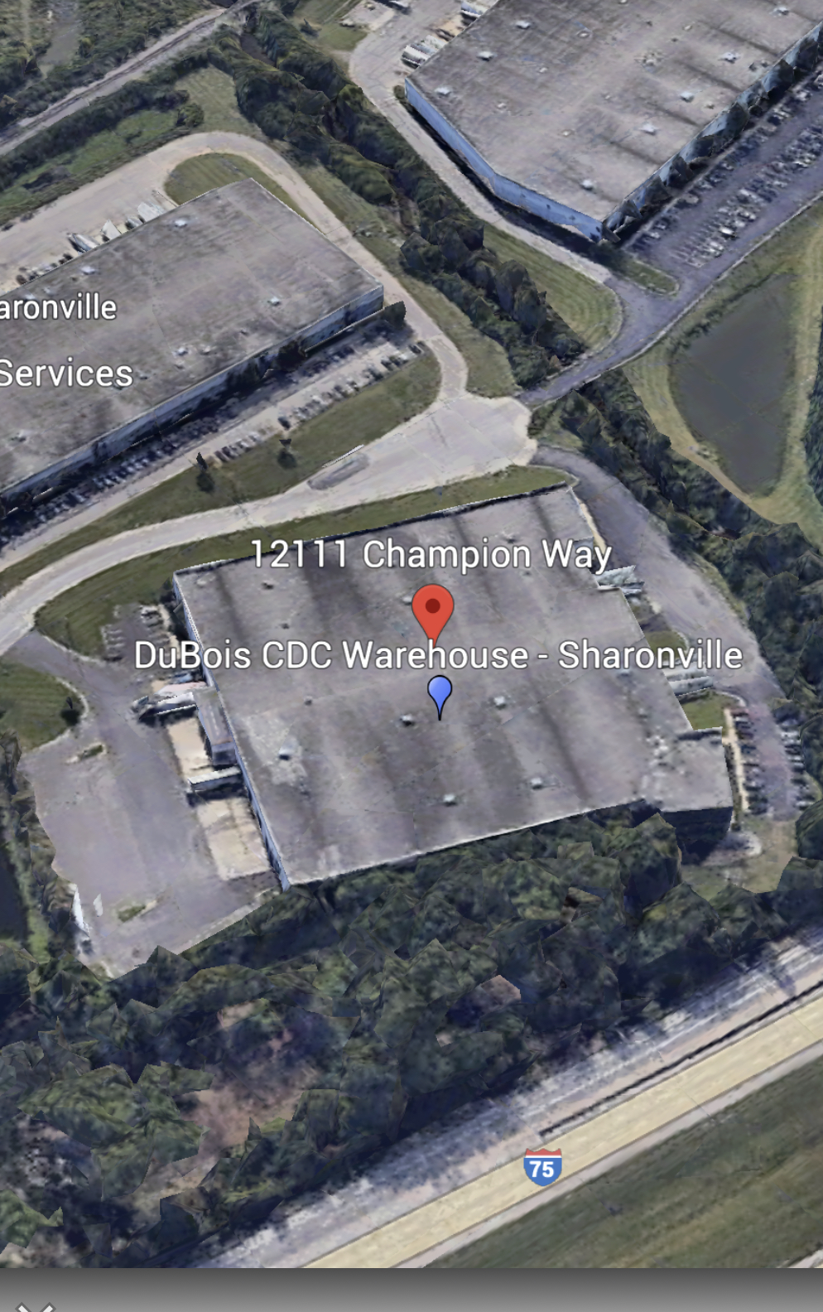
Dubois CDC Warehouse 12111 Champion Way

Slide 24
Sulfuric Acid- a strong acid made by oxidizing solutions of sulfur dioxide and used in large quantities as an industrial and laboratory reagent

Slide 25
Hydrogen Fluoride
Hydrogen fluoride is a chemical compound that contains fluorine. It can exist as a colorless gas or as a fuming liquid, or it can be dissolved in water.
When hydrogen fluoride is dissolved in water, it may be called hydrofluoric acid.
Hydrogen fluoride can be released when other fluoride-containing compounds such as ammonium fluoride are combined with water.
Where hydrogen fluoride is found and how it is used
Hydrogen fluoride is used to make refrigerants, herbicides, pharmaceuticals, high-octane gasoline, aluminum, plastics, electrical components, and fluorescent light bulbs. Sixty percent of the hydrogen fluoride used in manufacturing is for processes to make refrigerants.
Hydrogen fluoride is also used for etching glass and metal.
Swallowing only a small amount of highly concentrated hydrogen fluoride will affect major internal organs and may be fatal.
Hydrogen fluoride gas, even at low levels, can irritate the eyes, nose, and respiratory tract. Breathing in hydrogen fluoride at high levels or in combination with skin contact can cause death from an irregular heartbeat or from fluid buildup in the lungs.
Even small splashes of high-concentration hydrogen fluoride products on the skin can be fatal. Skin contact with hydrogen fluoride may not cause immediate pain or visible skin damage(signs of exposure).

Slide 26
Don't Try This at Home - 3 - Sulfuric Acid and Sugar - Bing video
https://www.youtube.com/watch?v=aBVdGGml6bU

Slide 27
Useful Tools

Slide 28
ERG Emergency Response Guidebook

Slide 29
Who do I contact?

Slide 30
Ohio EPA Spill Line 800-282-9378
Ohio EPA's spill hotline should only be used to report emergencies involving the release of any material that impacts public health or the environment, including chemicals, petroleum, manure, fires/explosions, or to make an emergency notification to Ohio EPA as required by law or by permit.
Please remember that all spills affecting waterways (creeks, storm sewers, sanitary sewers, rivers, lakes) MUST be reported to the OEPA regardless of amount
Any spills over 25 gallons must be reported to OEPA and Hamilton County LEPC

Slide 31
Ohio EPA 800-282-9378
When reporting a spill, release or environmental crime through the spill hotline, be prepared with as much of the following information as possible:
Responsible party (name of carrier, owner, operator or facility).
Date/time (discovered/occurred).
Location (address, cross street, mile marker).
Material(s) (chemical, product, or common name).
Quantity (estimated release/total).
Hazards (extremely hazardous substance, placard, materials safety data sheet [MSDS]).
Affected media/area (air, land or waterway, including threats to ditches, sewers, streams).
Actions/notifications (evacuations, containment, contractor hired).
Contacts on scene (responder cell phone number, responsible party, contractor, facility point of contact).
Other useful information (truck DOT or rail car number, chemical UN ID number, MSDS, etc.).

Slide 32
Hazmat Contact Info
1881 E Crescentville Road
We are in the old Sharonville Fire Station
Office 513-779-1200
M-F 830-330
Fax 513-779-0703
www.gchmu.org
Brooke Matzen – Office Administrator
Brmatzen@gmail.com

